Slide 1

PLAYSTORE PROJECT
Analysis
Attributes
Objective
About
Report with findings and recommendations
Submitted By SHAILEE DWARKANI

Slide 2
Android app development company
To identify best fit app attributes
Analysis
Attributes
Objective
About
Drive maximum installs and revenue

Slide 3



NEW APP DEVELOPMENT
Analysis
Attributes
Objective
About
Customary
Unexplored
Subscription
Identify App attributes for regular sectors – high demand and high availability
Identify App attributes for unexplored sectors – high demand but less availability
Identify App attributes for subscription sectors – users ready to pay for app services

Slide 4





10 K
Category
Genre
Size
Content
Price
Category
Genre
Size
Content
Price
Installs
Average Rating
Reviews
1
2
3
4
5
Based on
Based on
Based on
Based on
Based on
Analysis
Attributes
About
Availability
Installs/ Reviews
Revenue
Availability
Installs/ Reviews
Revenue
Availability
Installs/ Reviews
Revenue
Availability
Installs/ Reviews
Revenue
Availability
Installs
Revenue
No major impact of Ratings, most ratings lie in highest band
No of reviews show a positive correlation with no of installs
Availability of more apps in each category shows a slight correlation with the no of installs

Slide 5
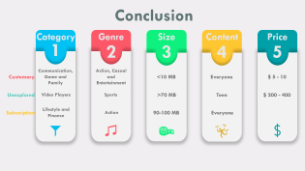
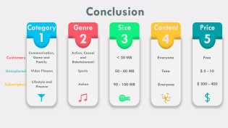
Category
Category
Genre
Size
Analysis
Attributes
About
Content
Price

Slide 6
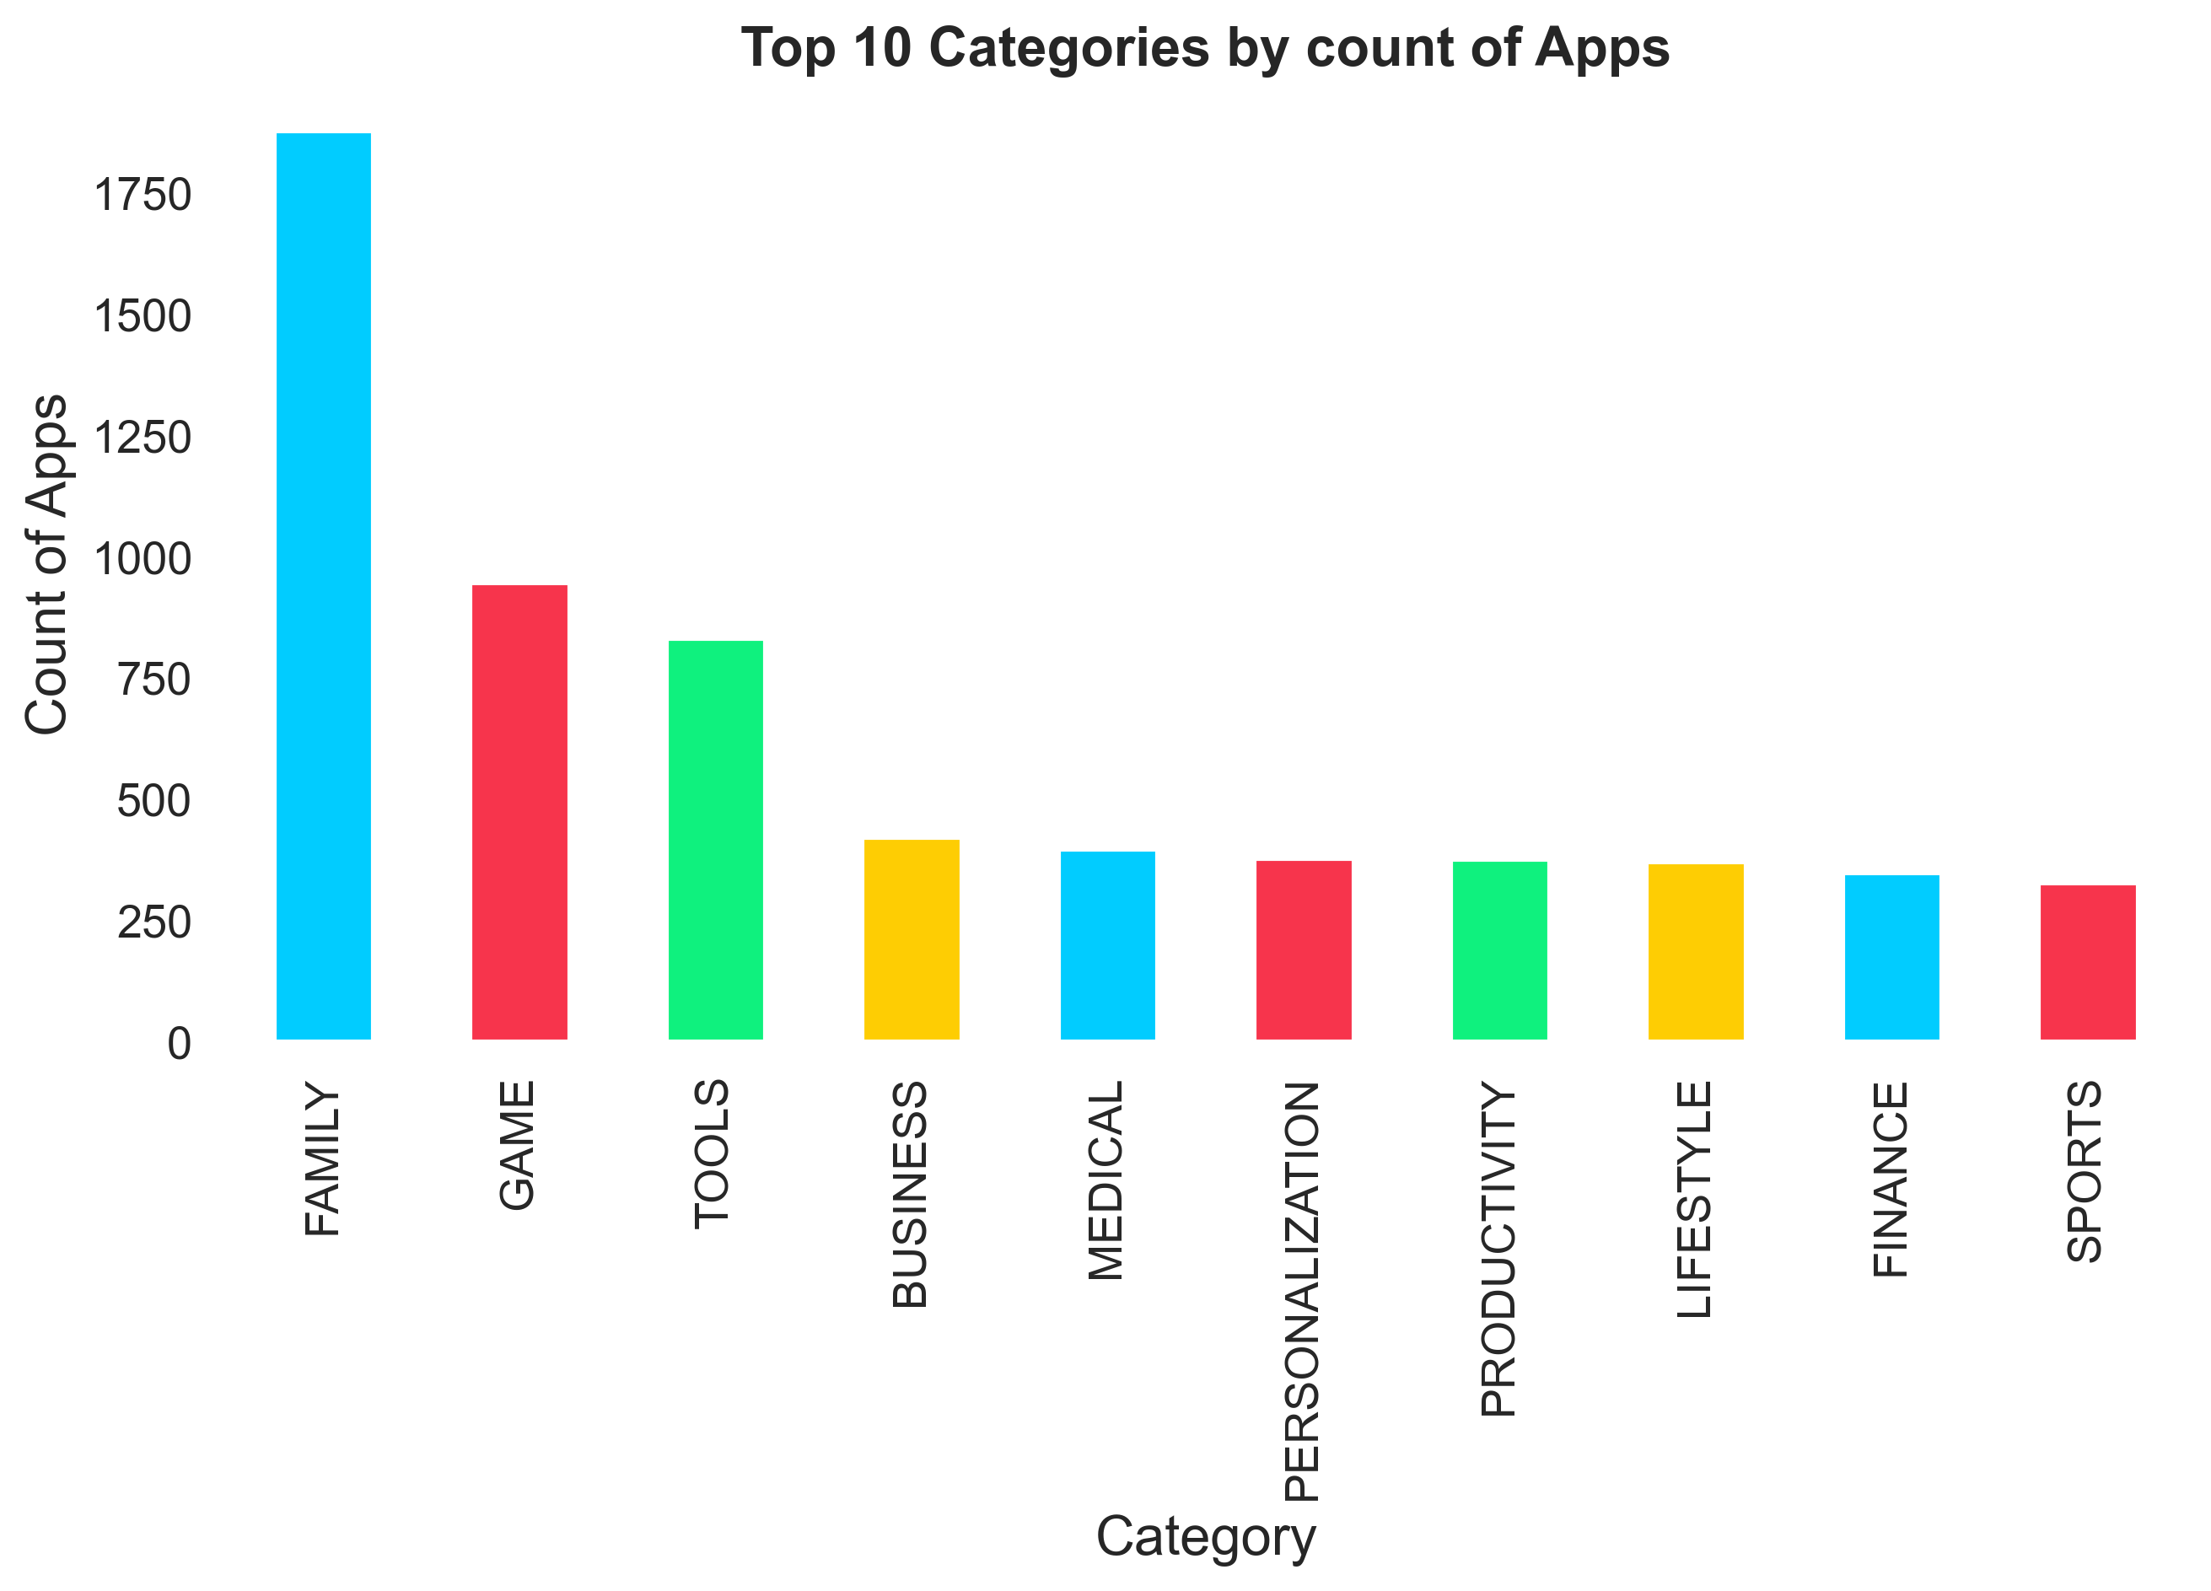
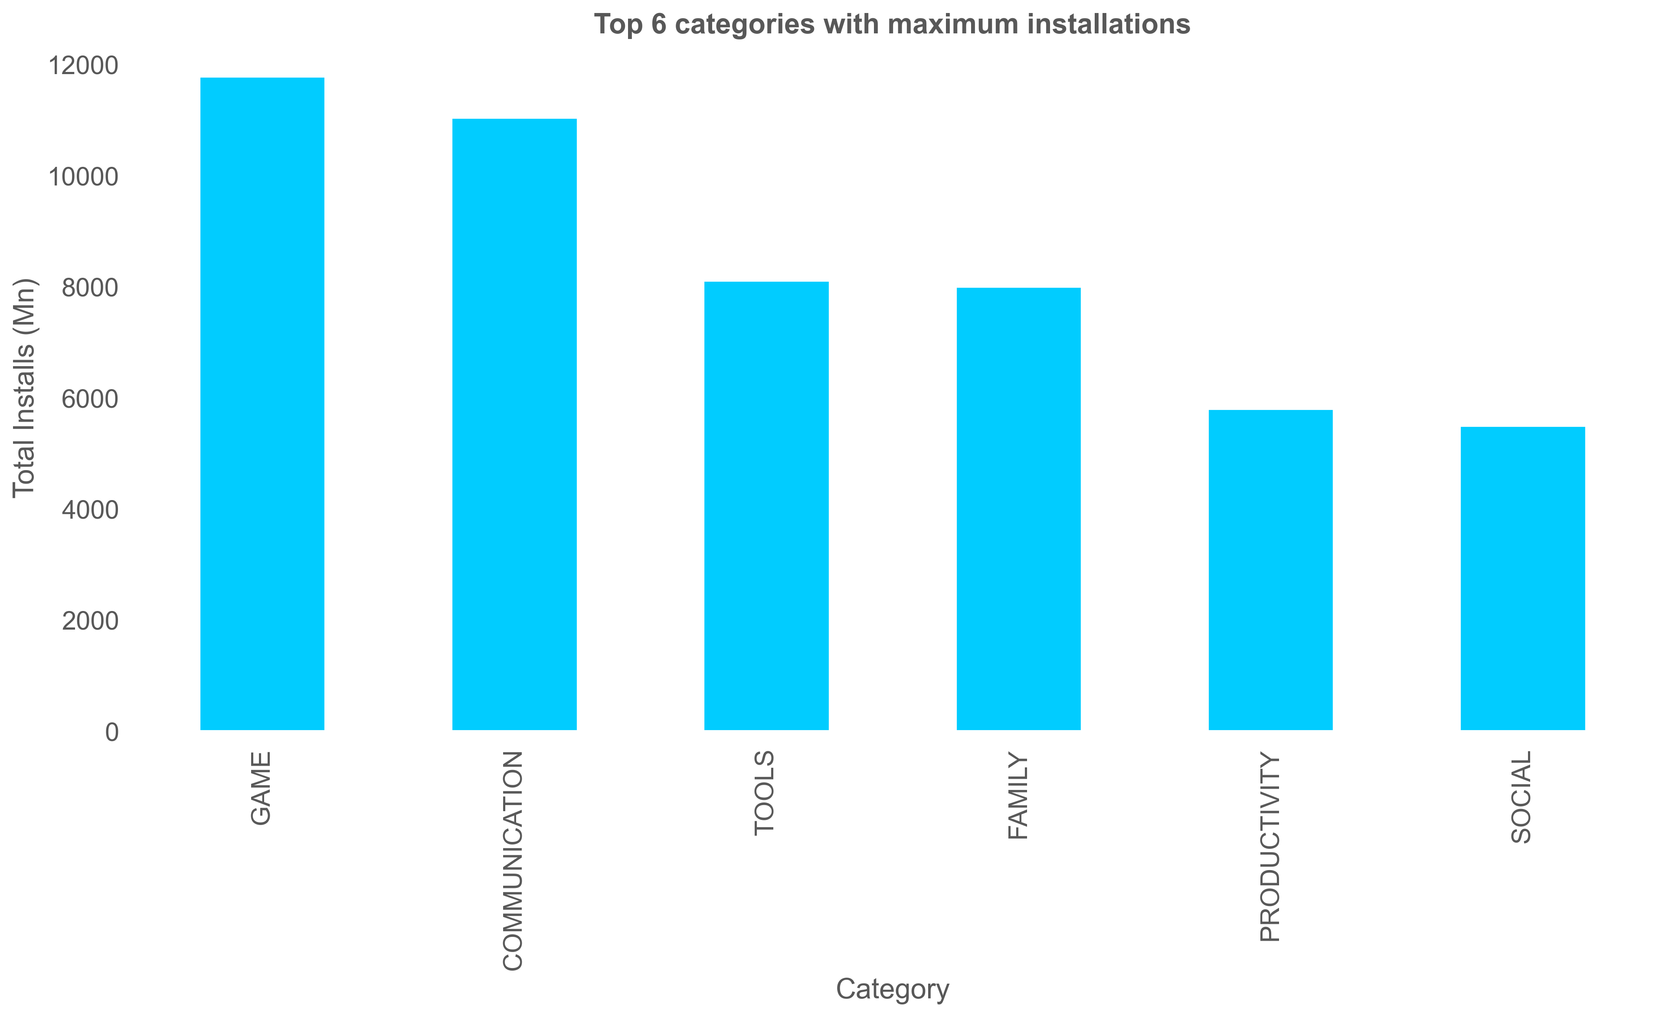
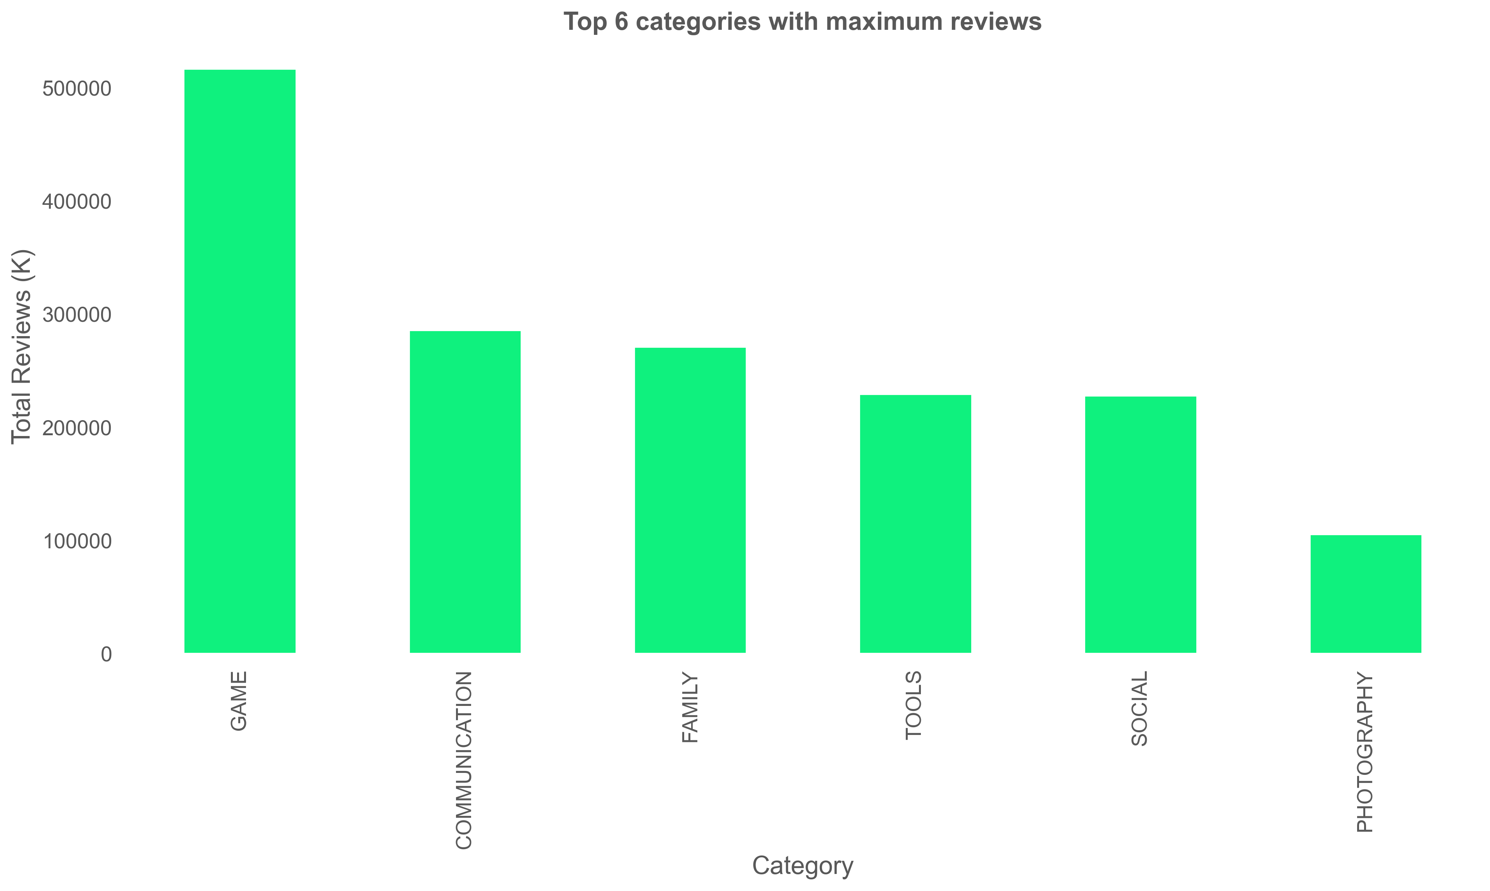
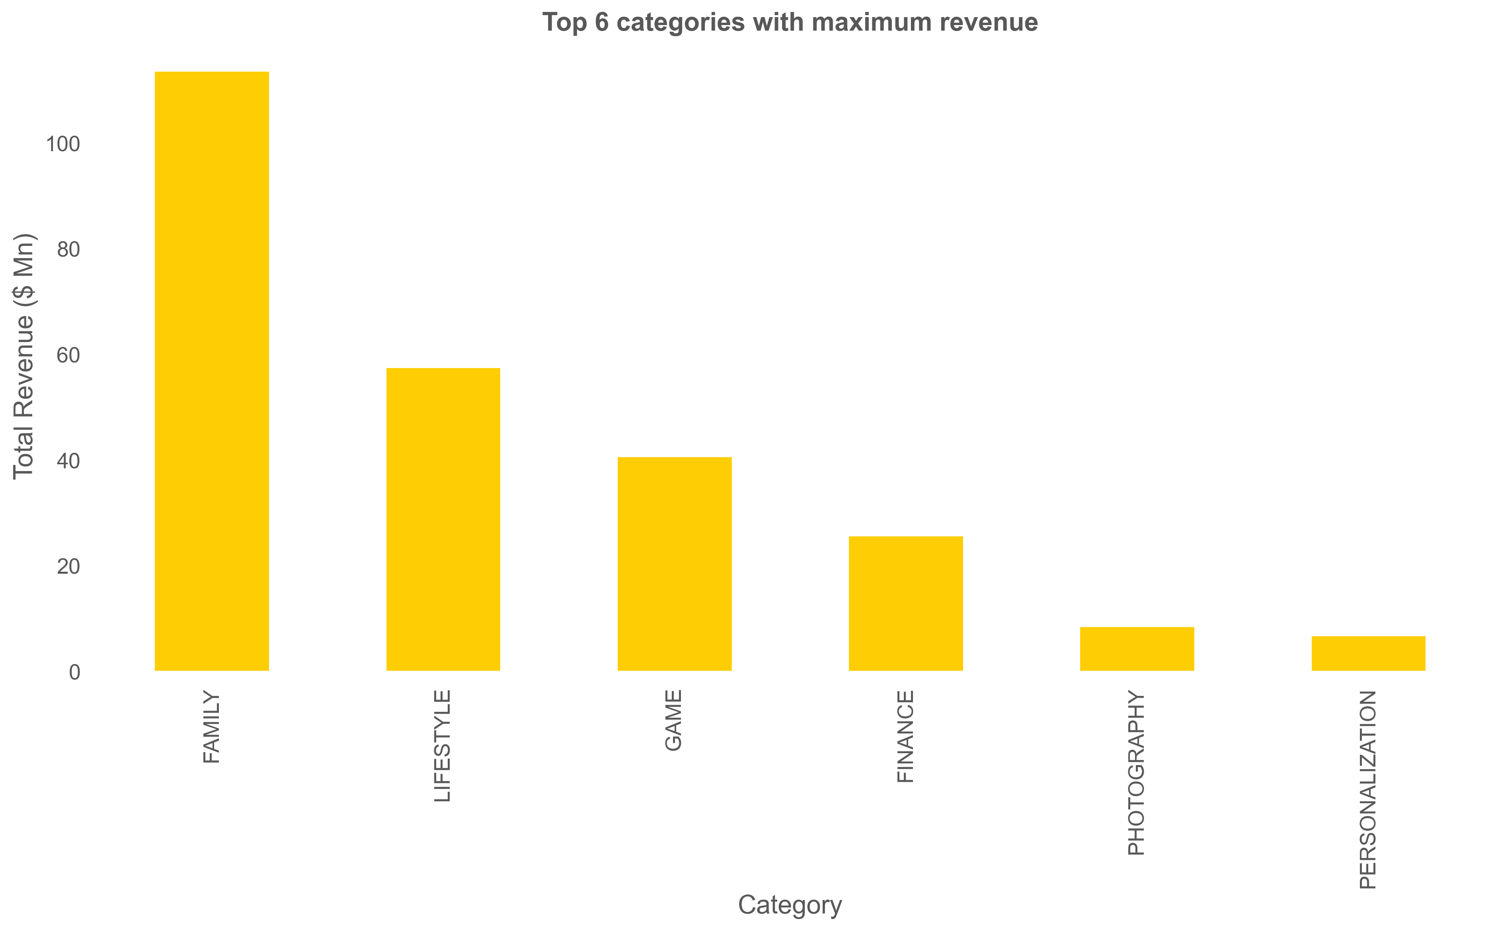

Slide 7
10 – 65%
3 – 38%

Slide 15
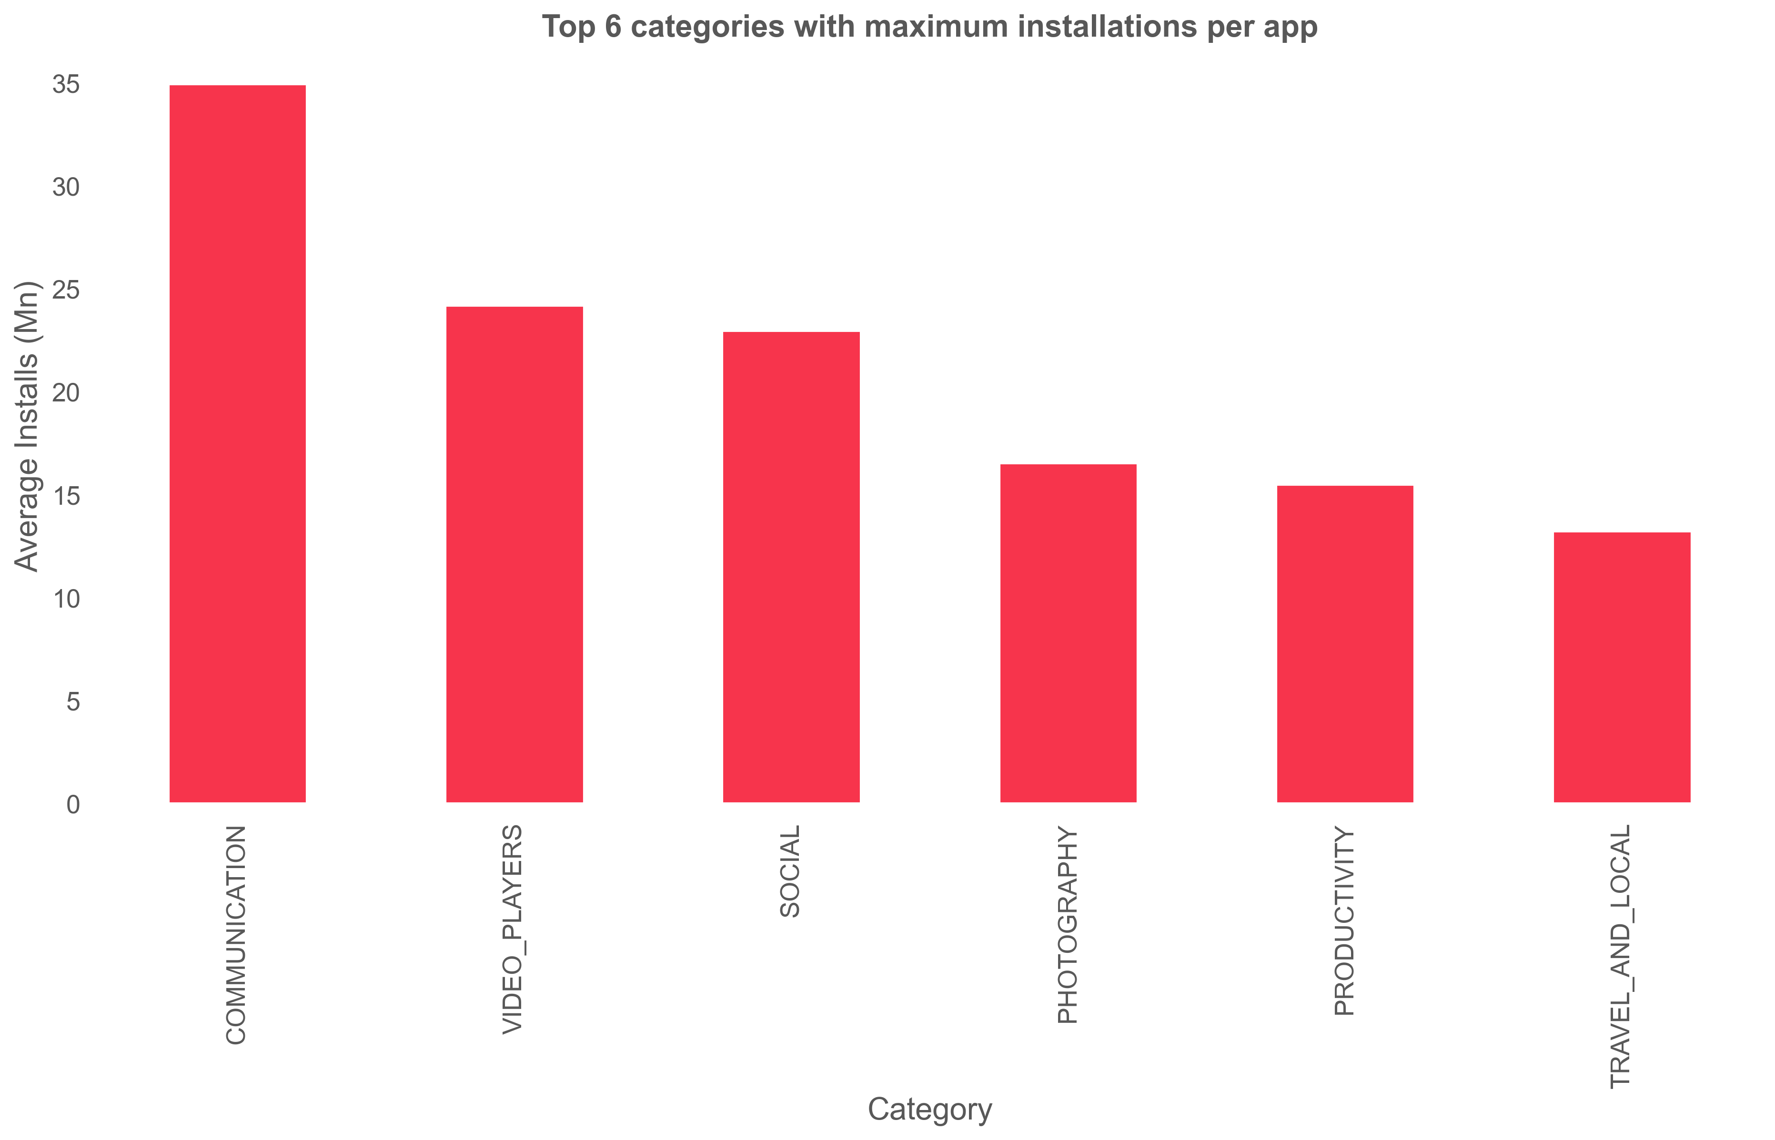
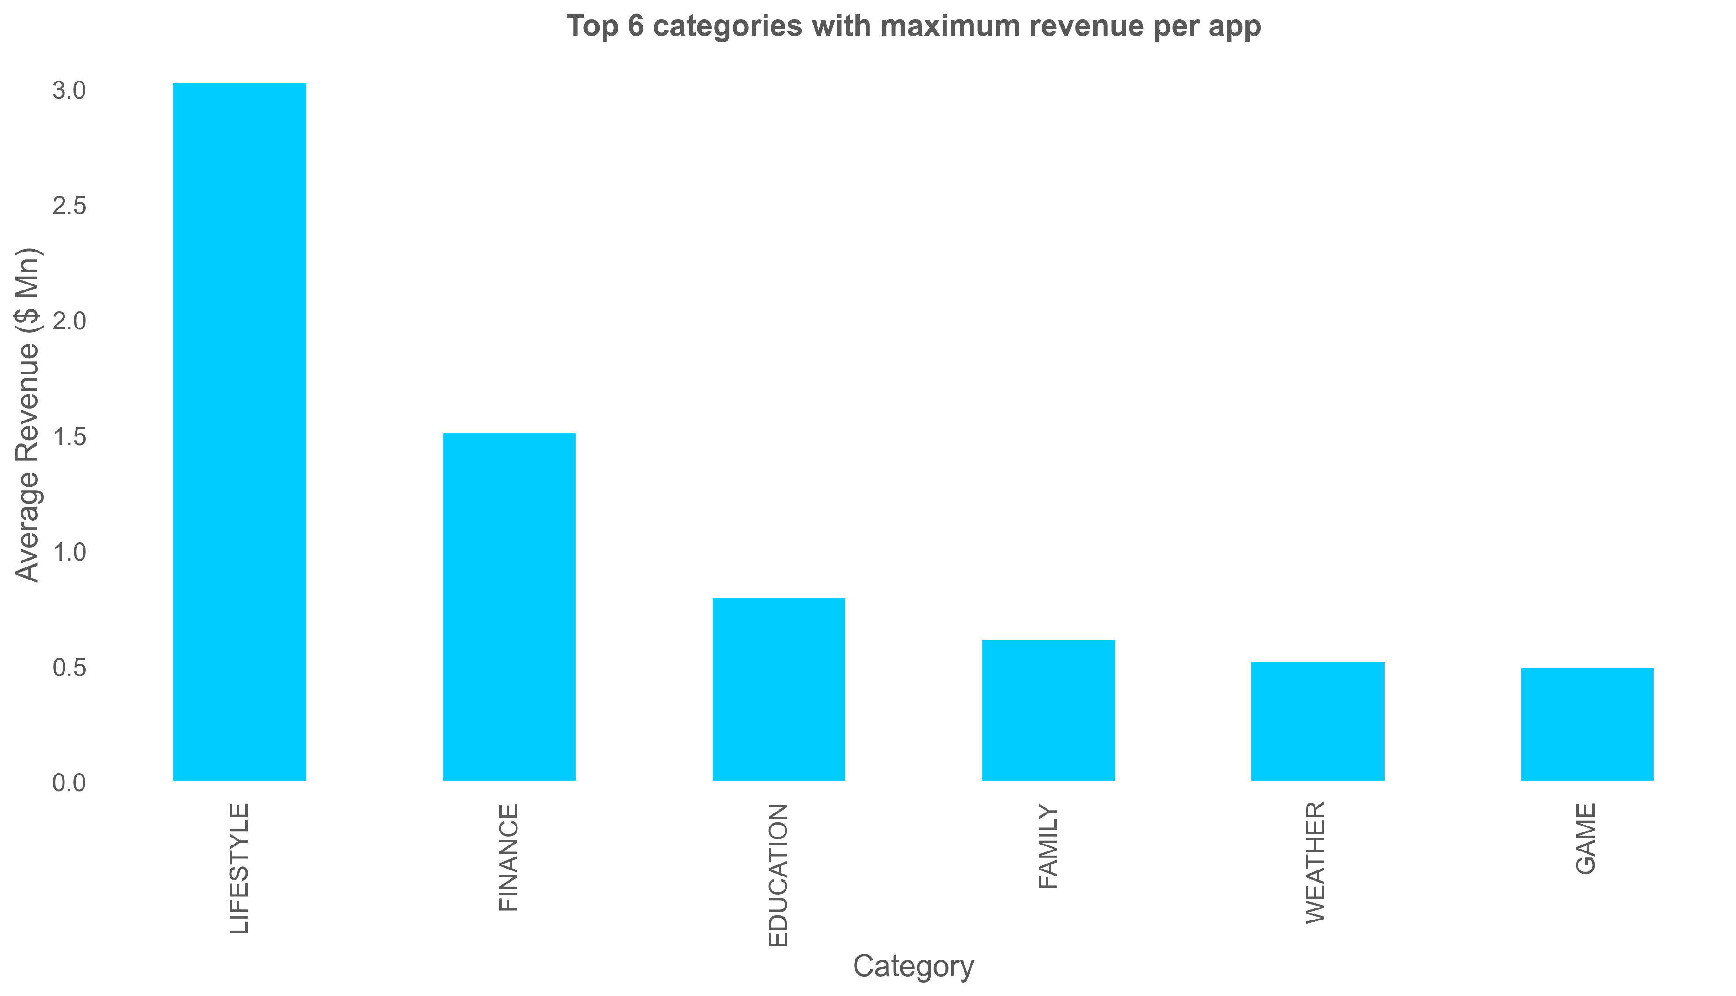
Top categories with maximum installations per app
Top categories with maximum revenue per app

Slide 16
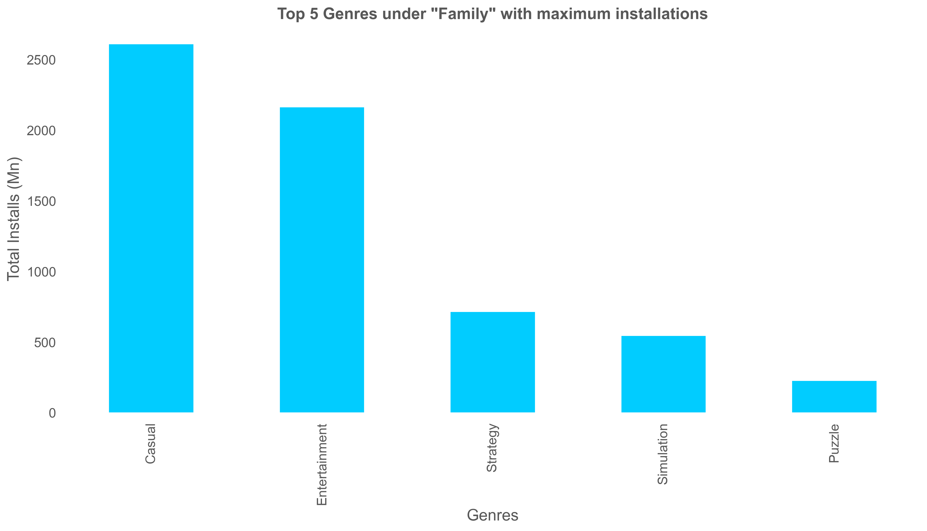
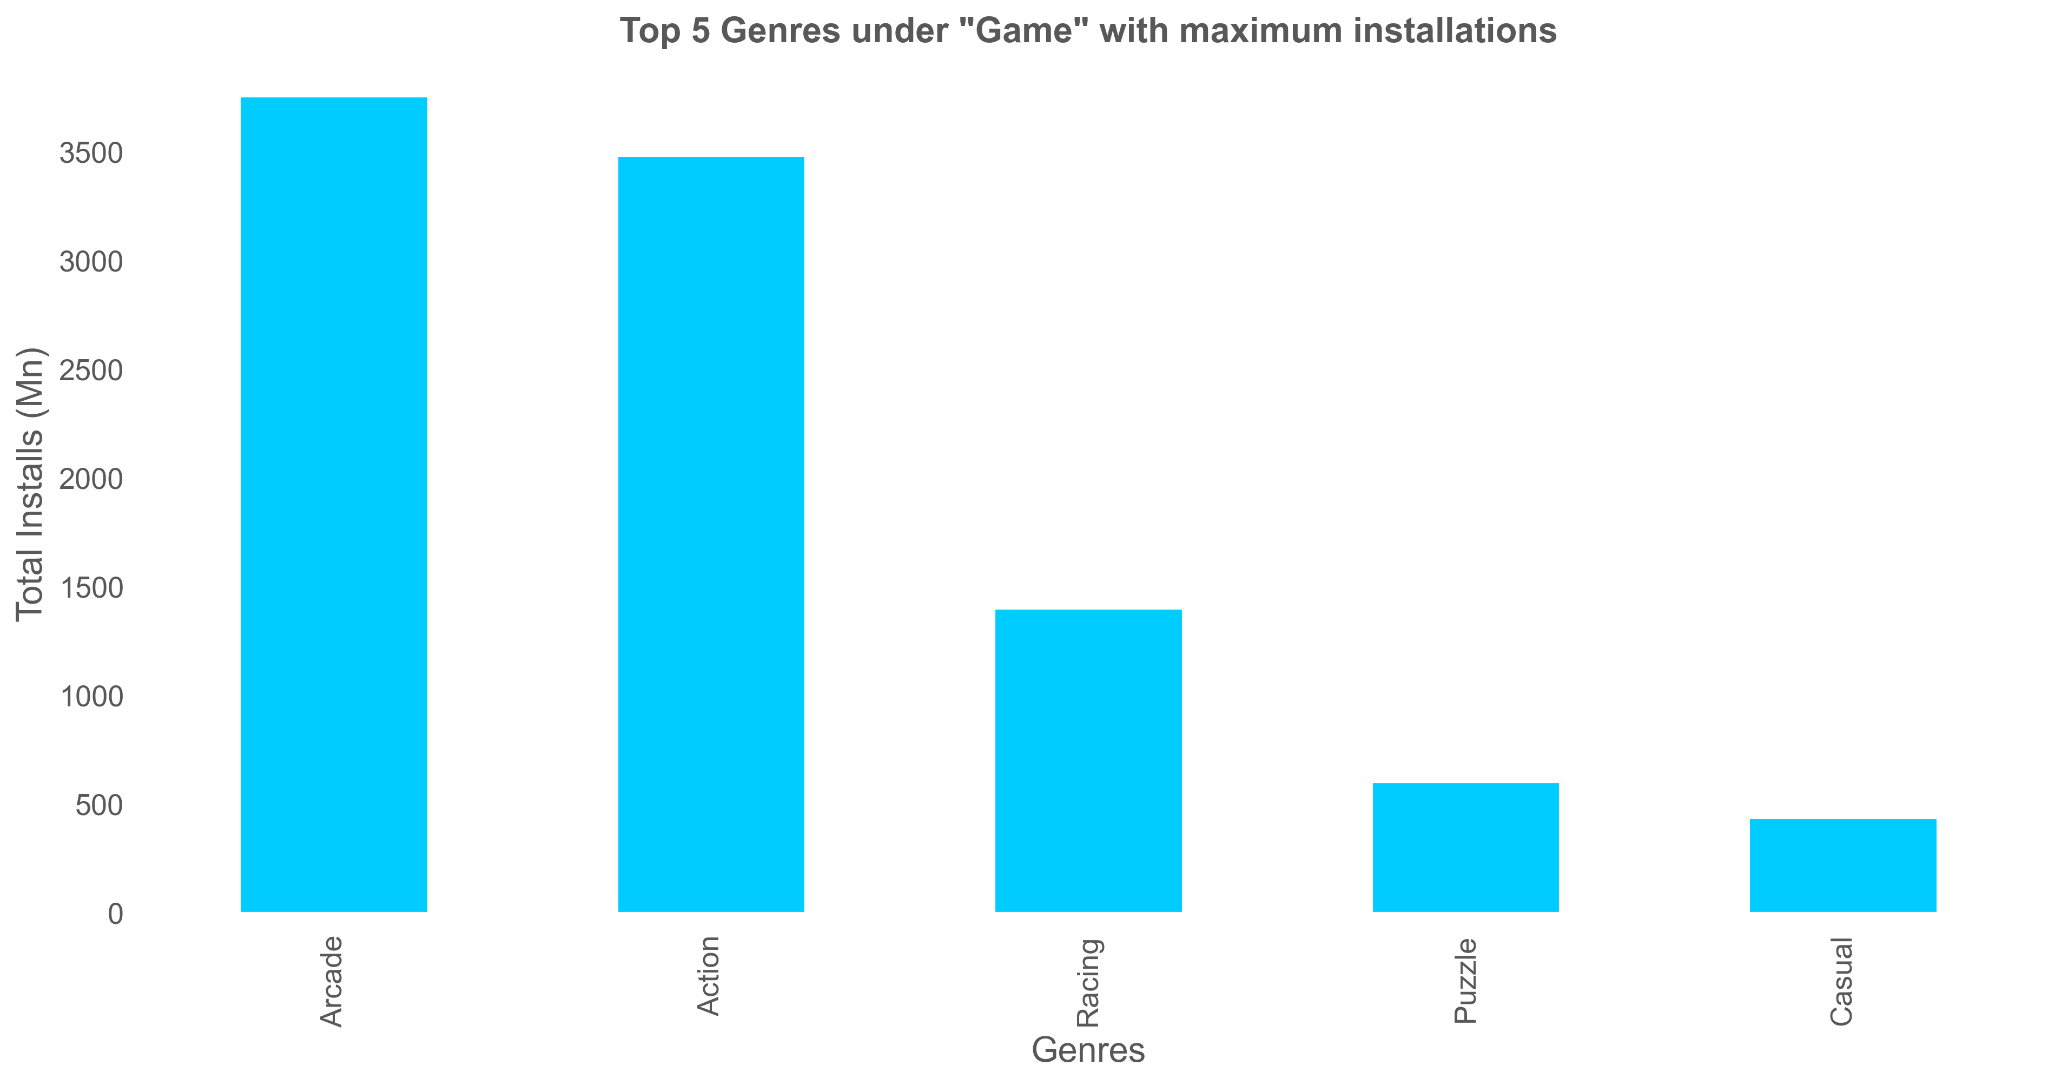
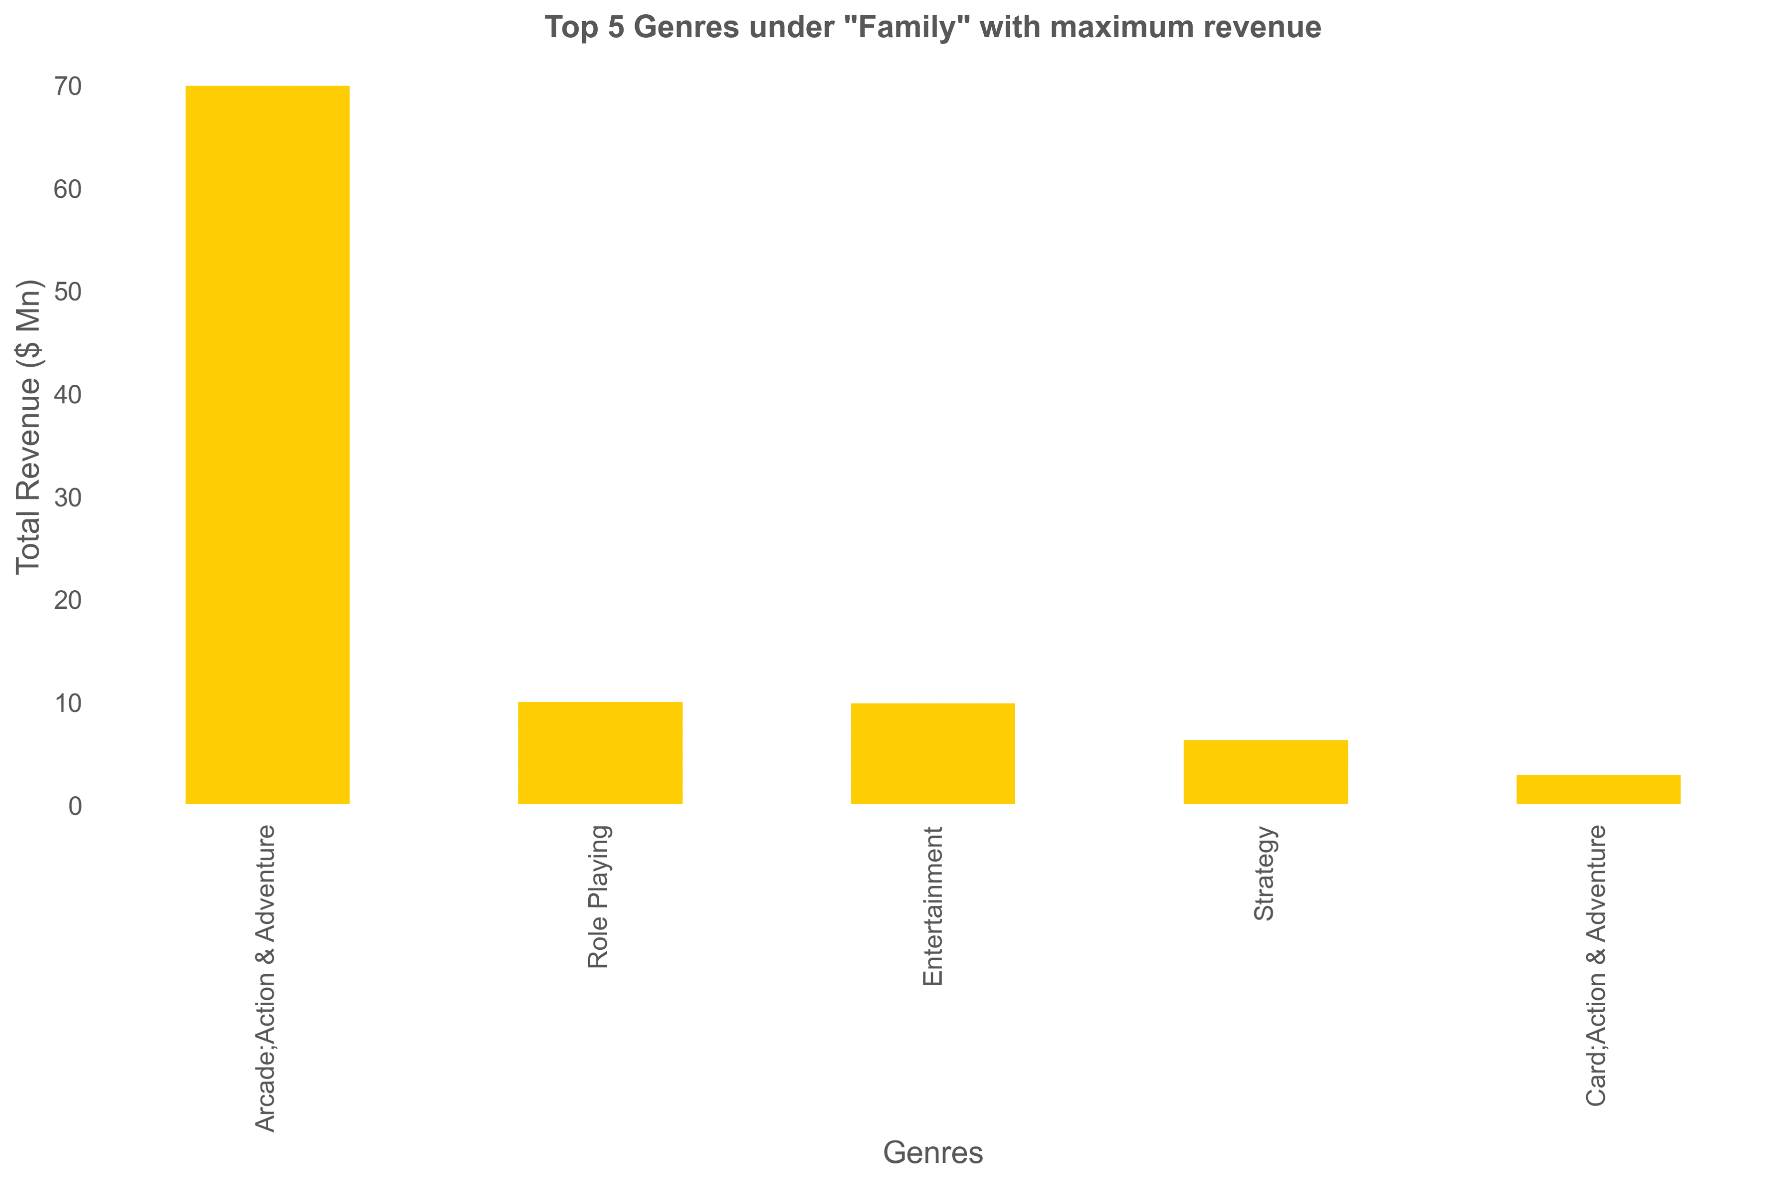
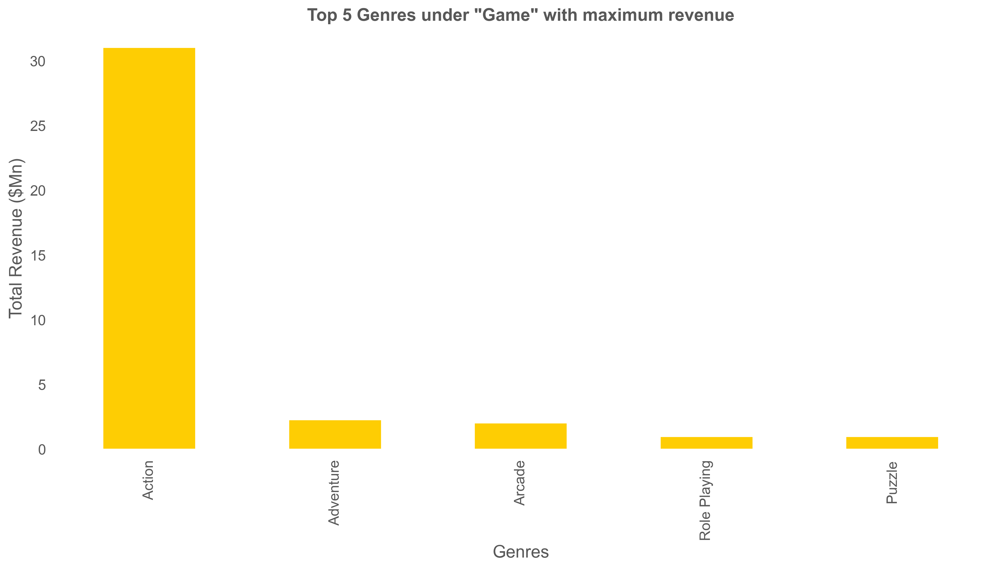
92/118

Slide 21
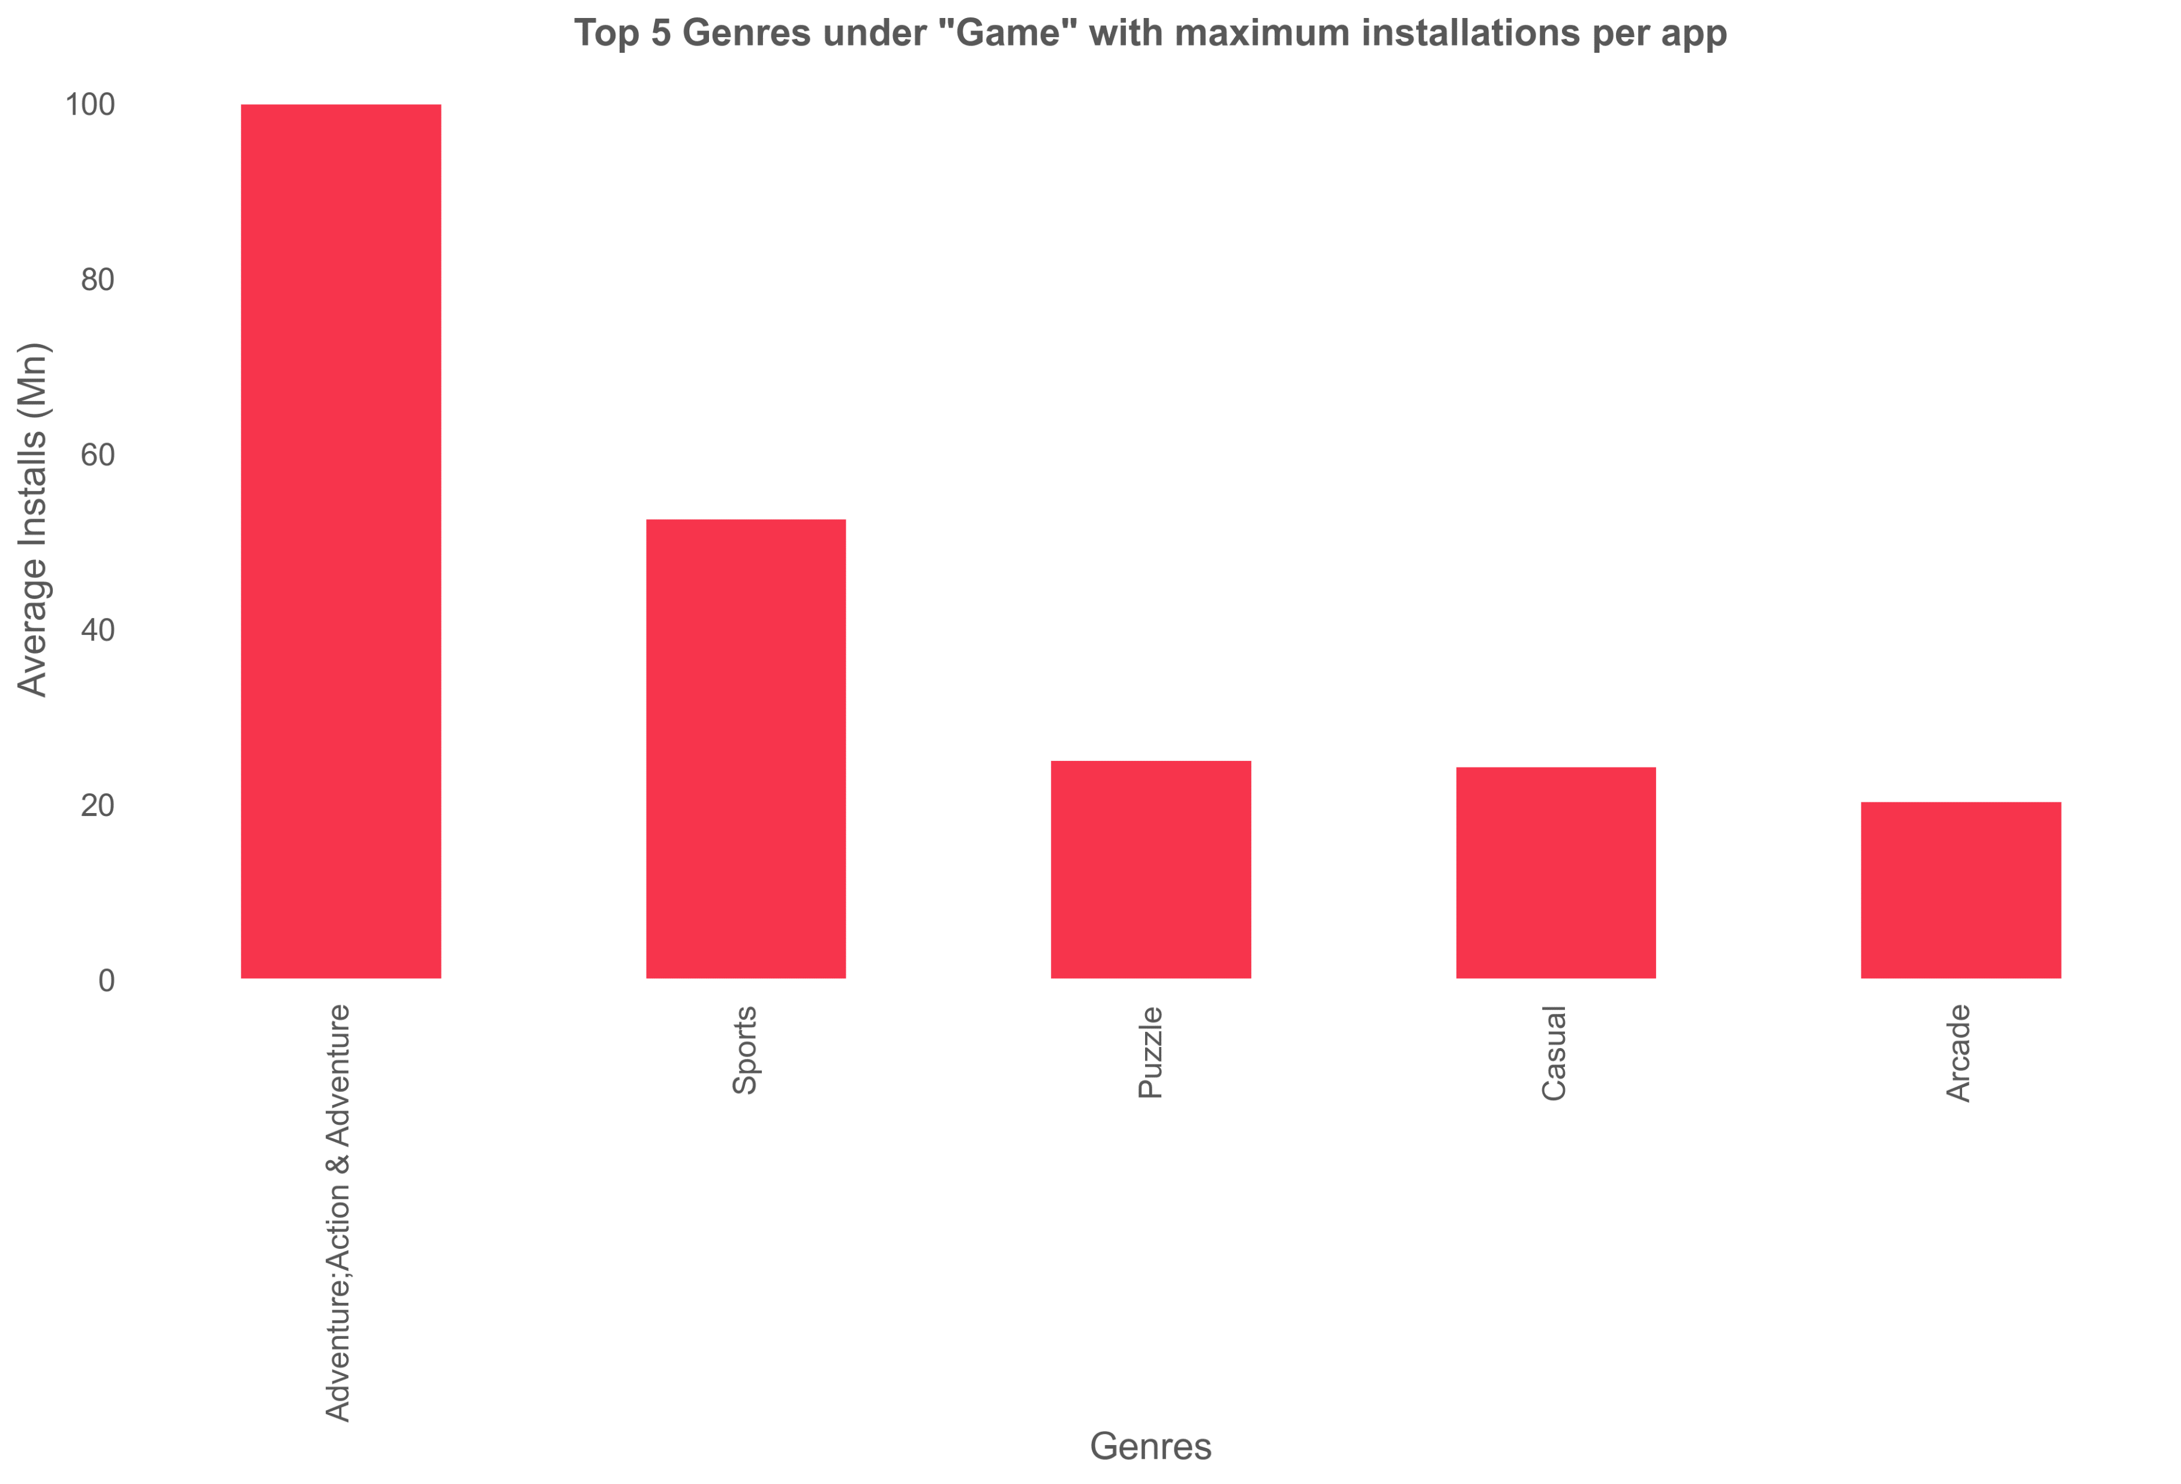
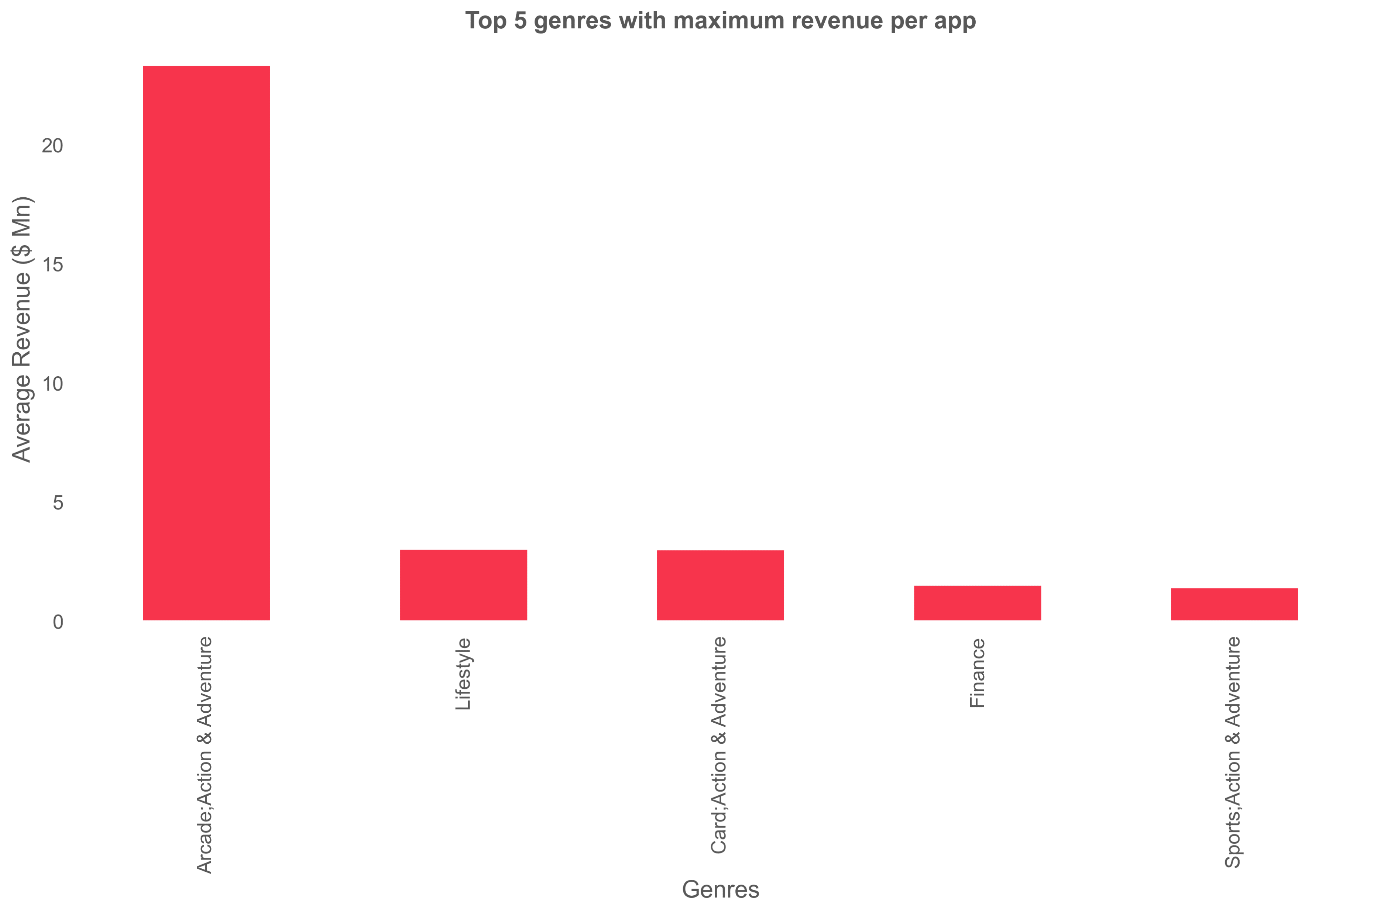
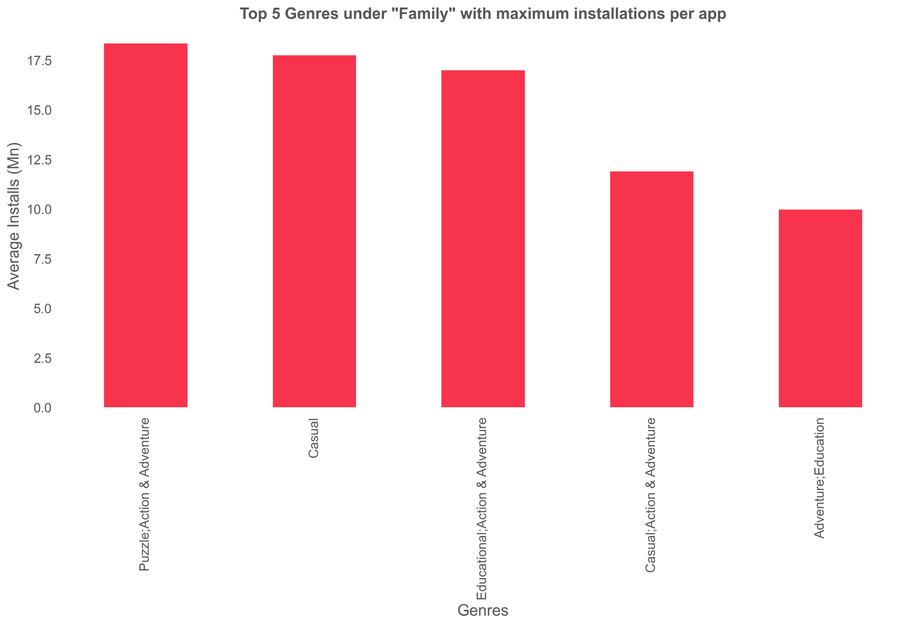

Slide 26
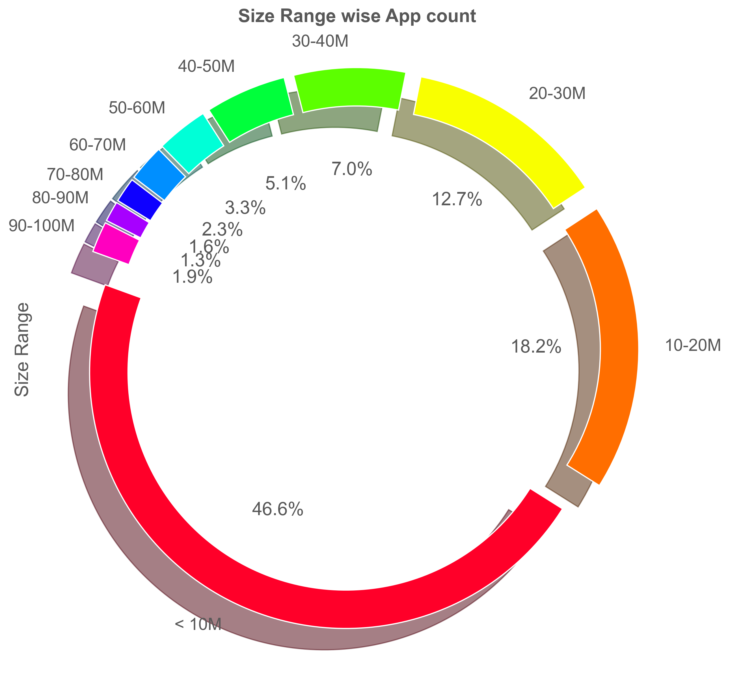
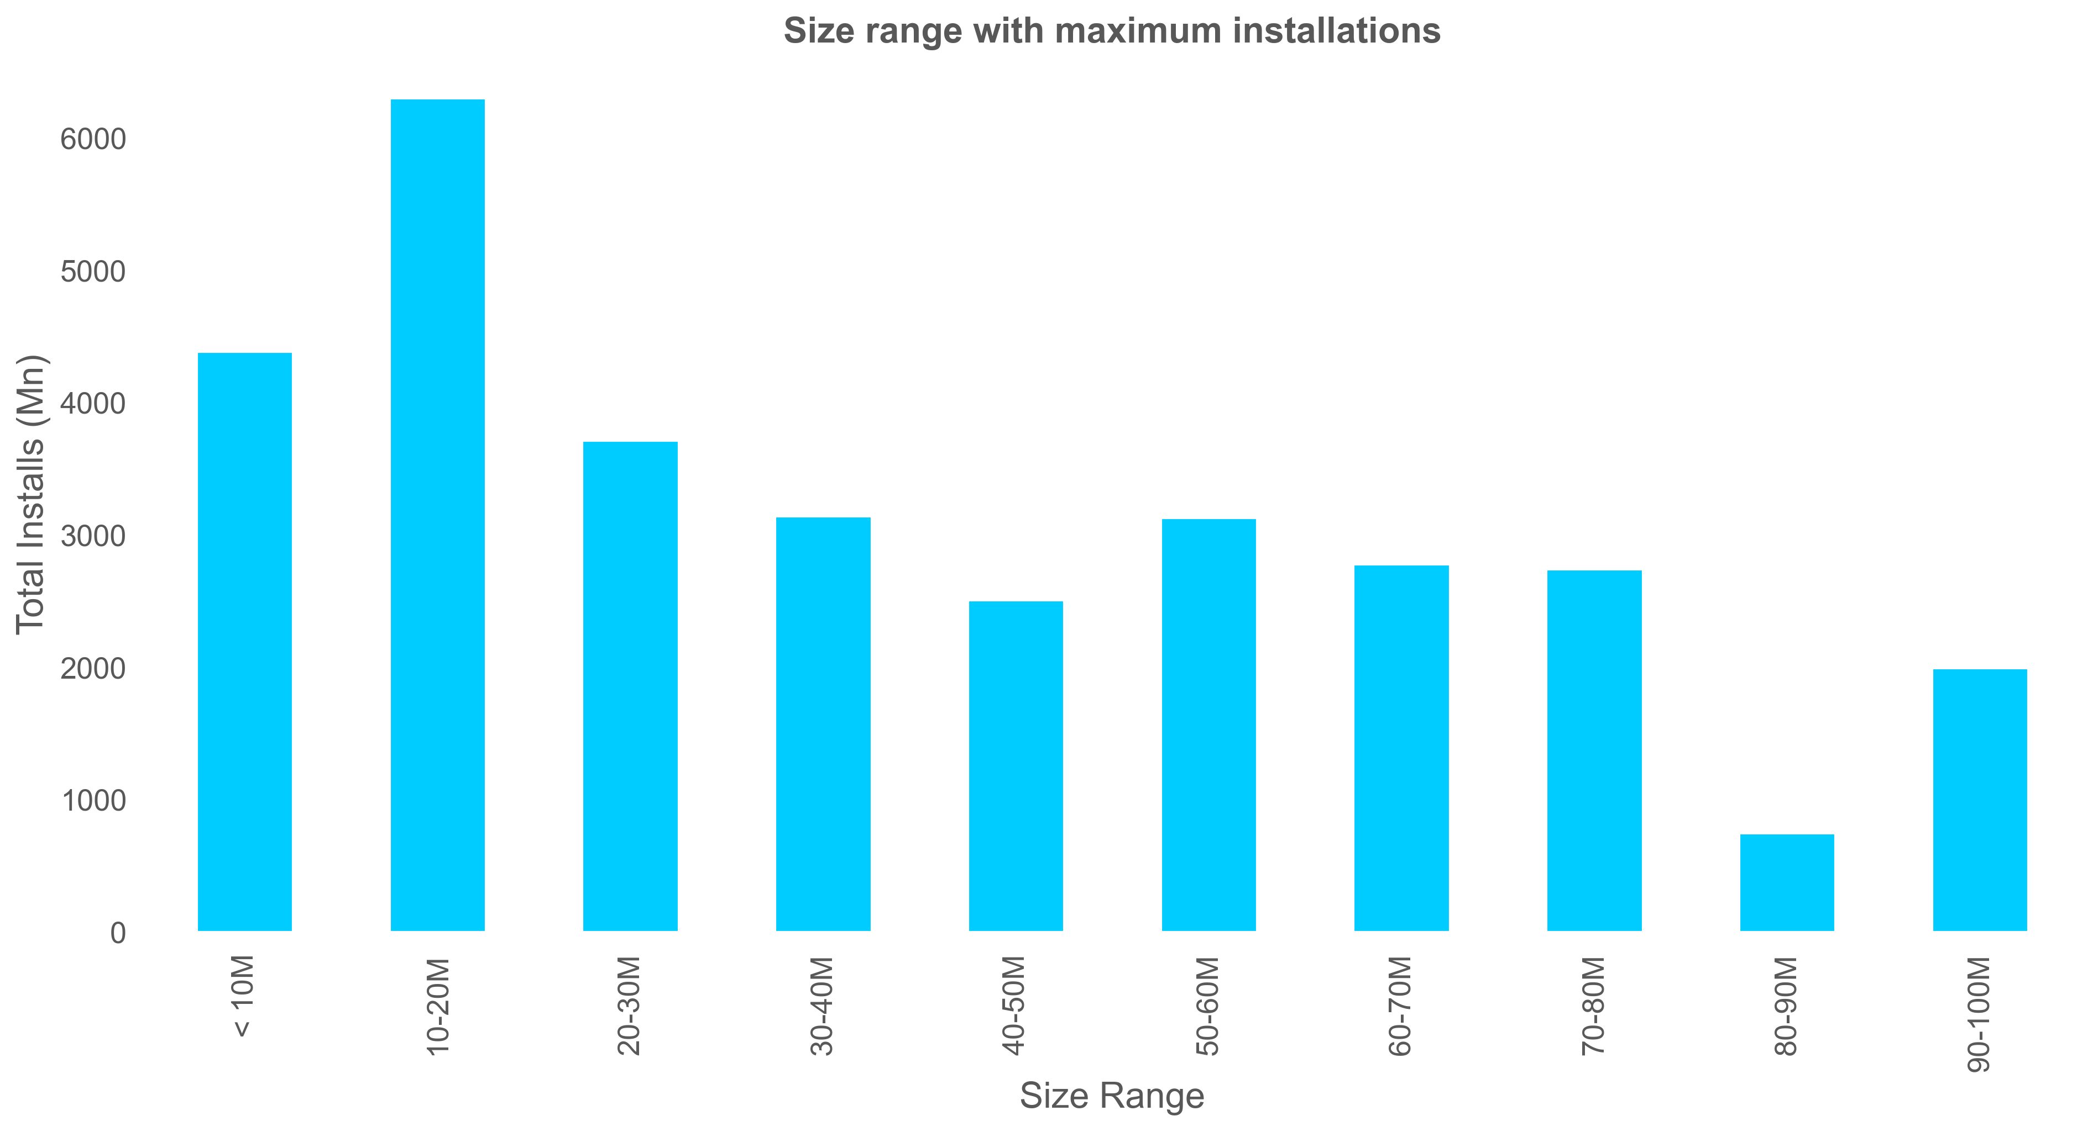
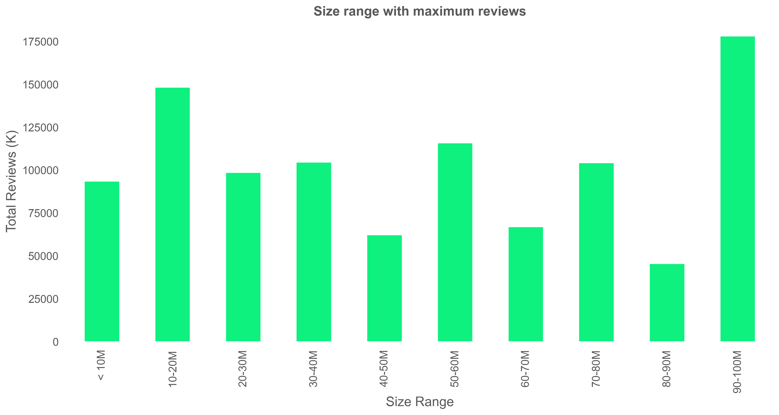
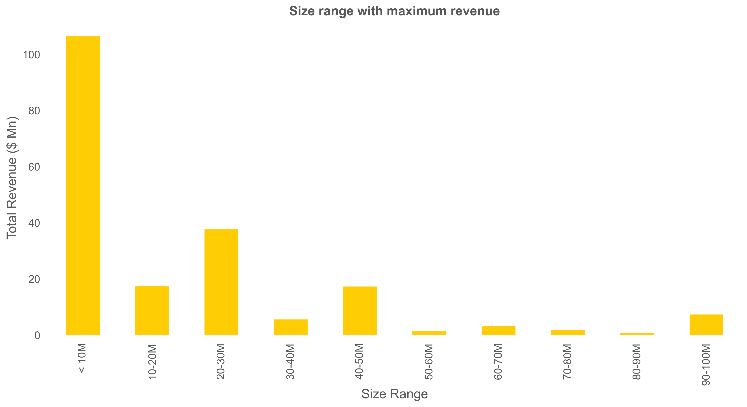
65%

Slide 33
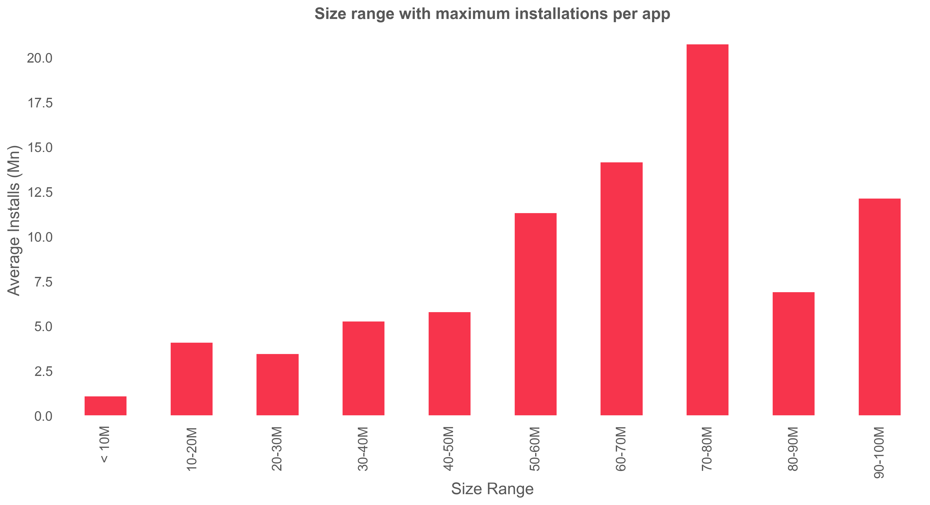
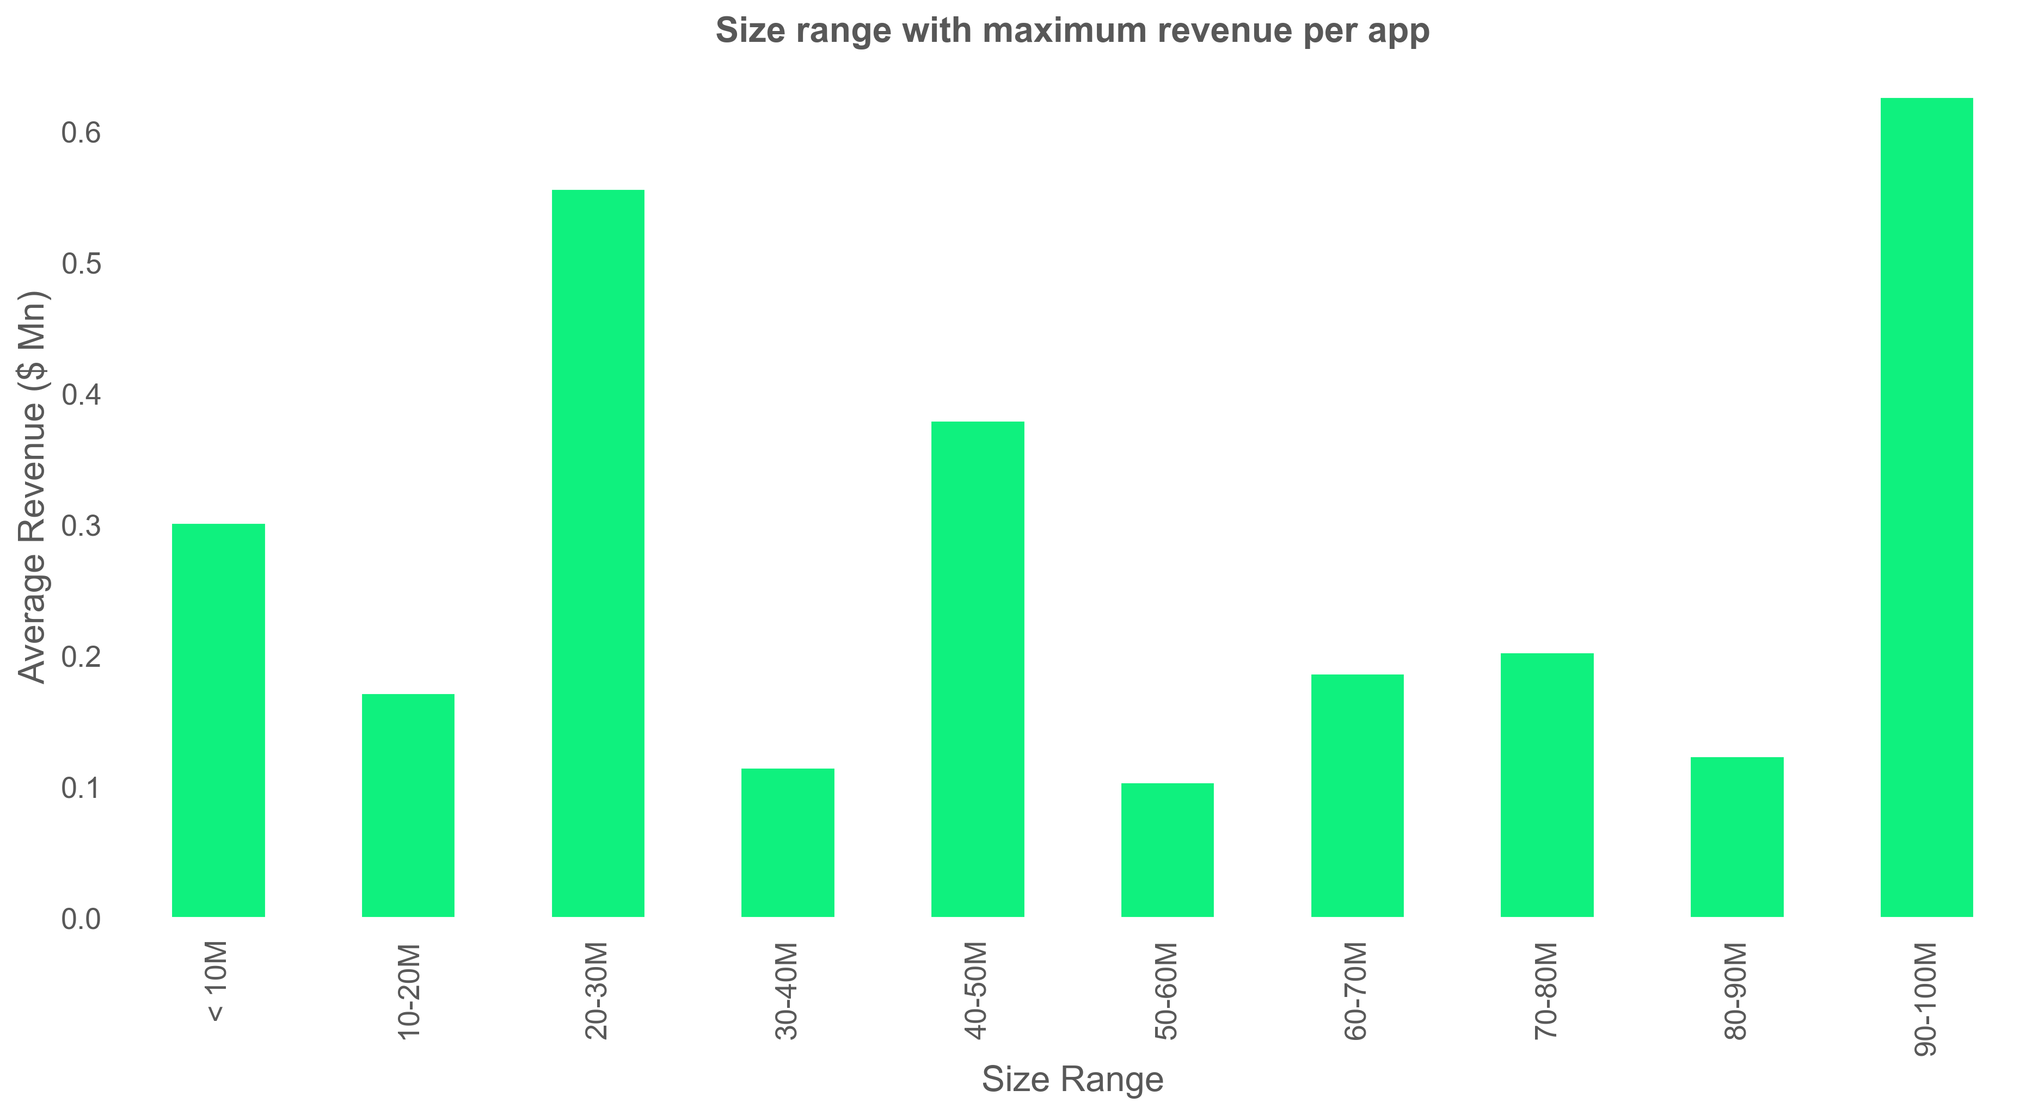
Size range with maximum installations per app
Size range with maximum revenue per app

Slide 34
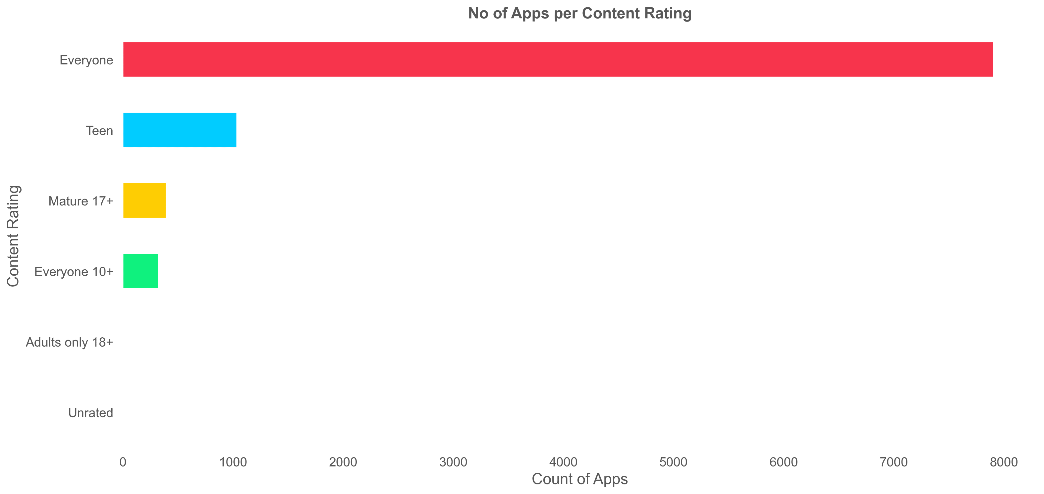
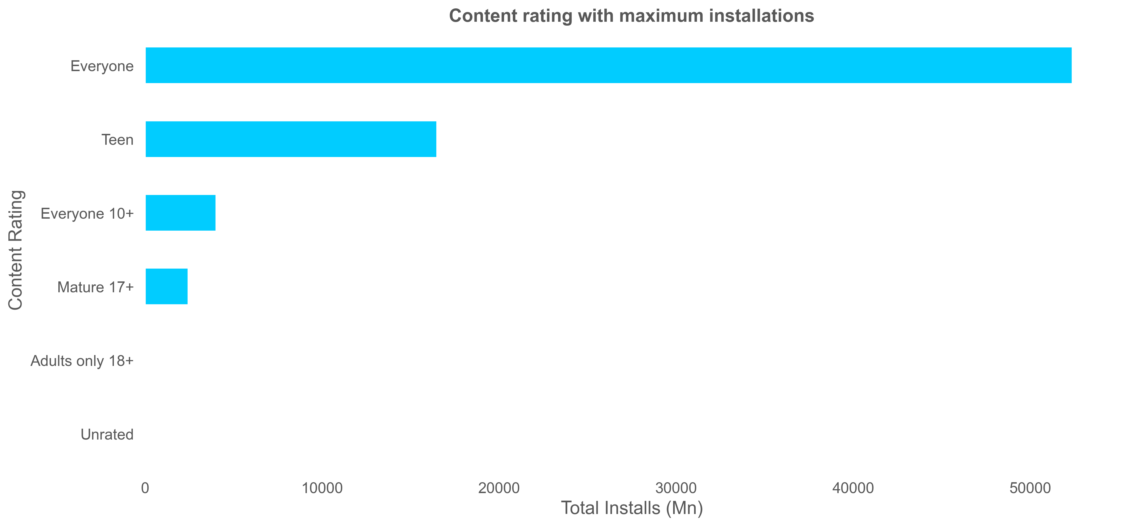
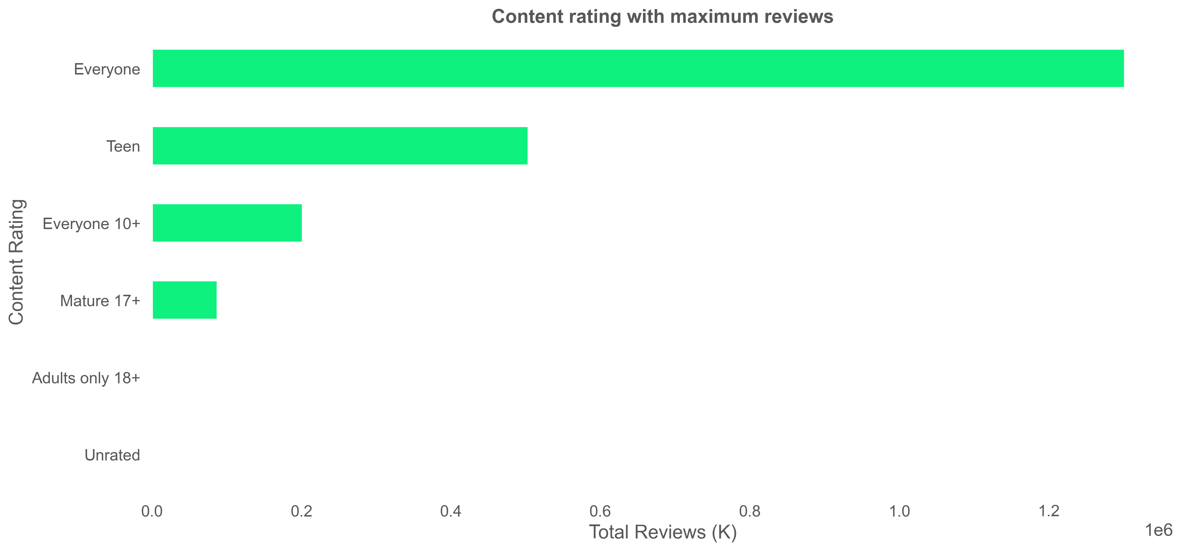
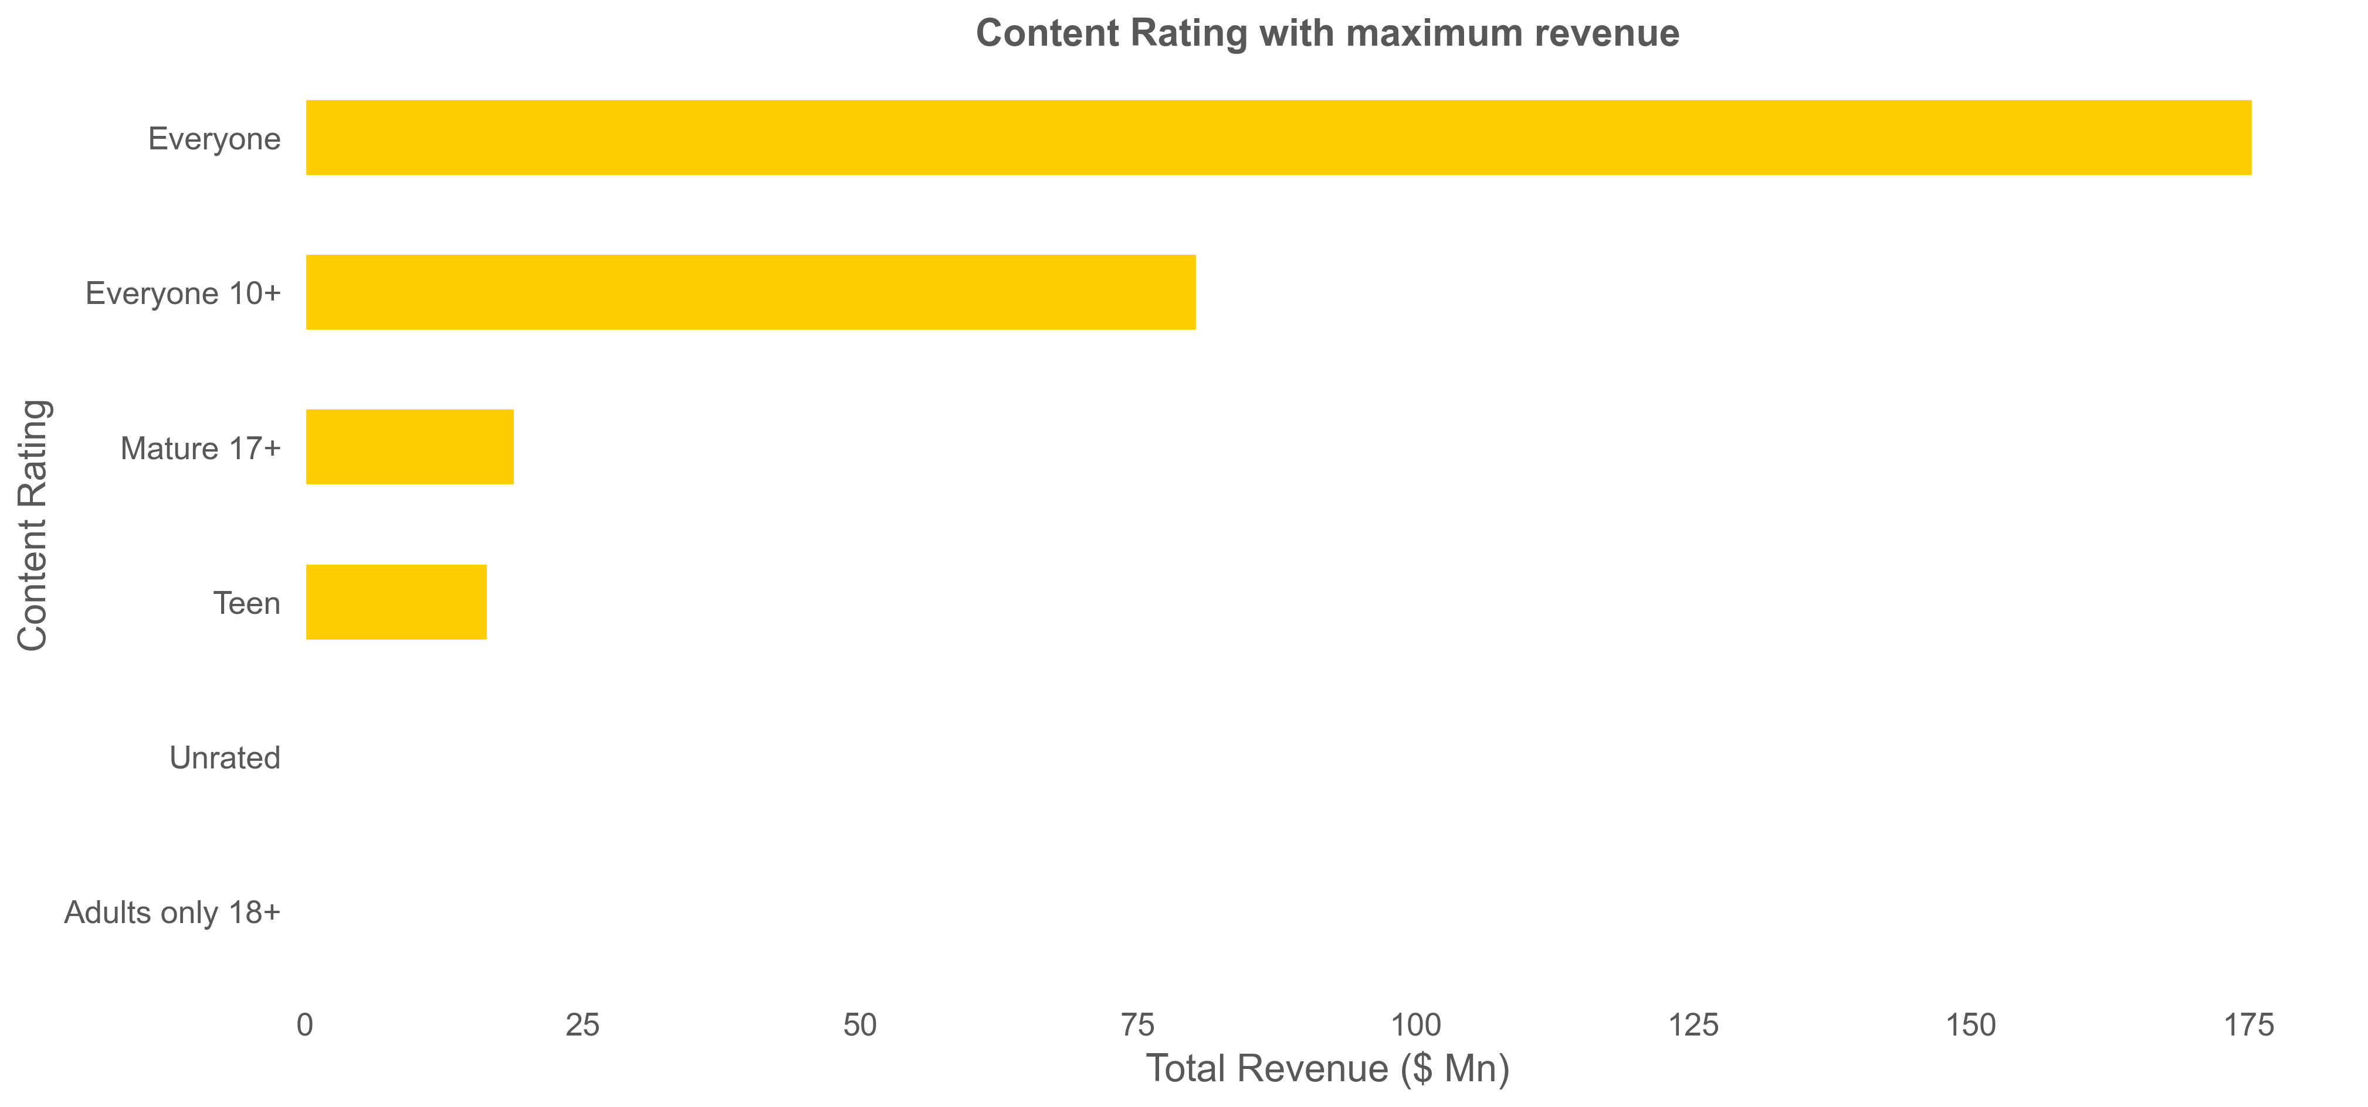

Slide 35

80%

Slide 43
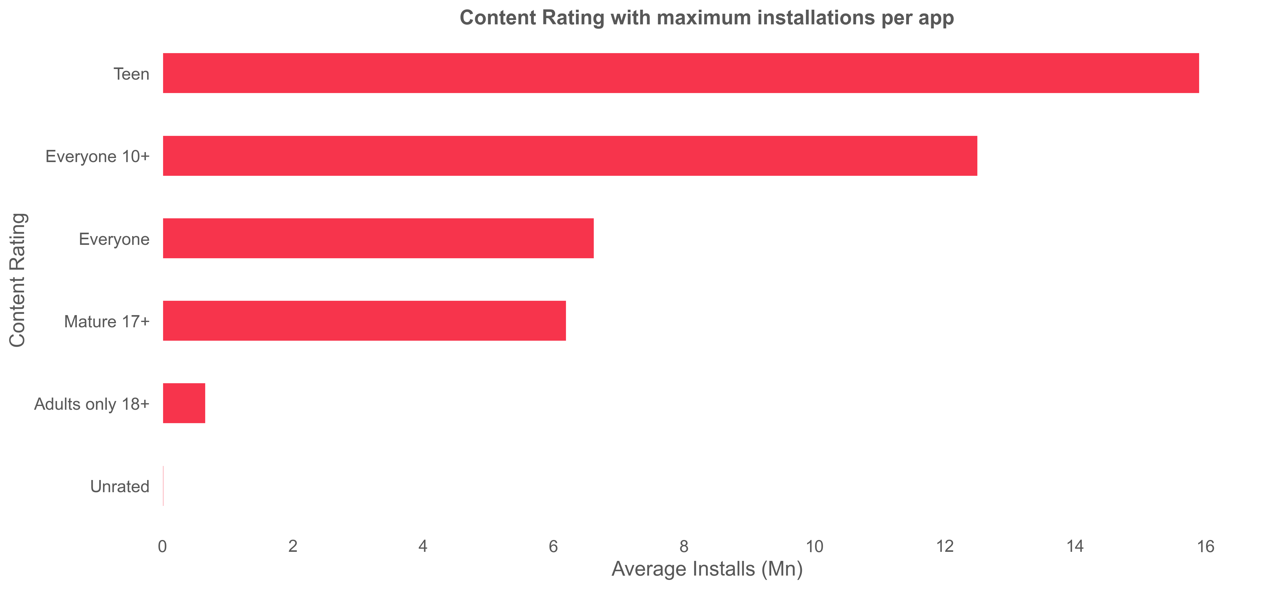
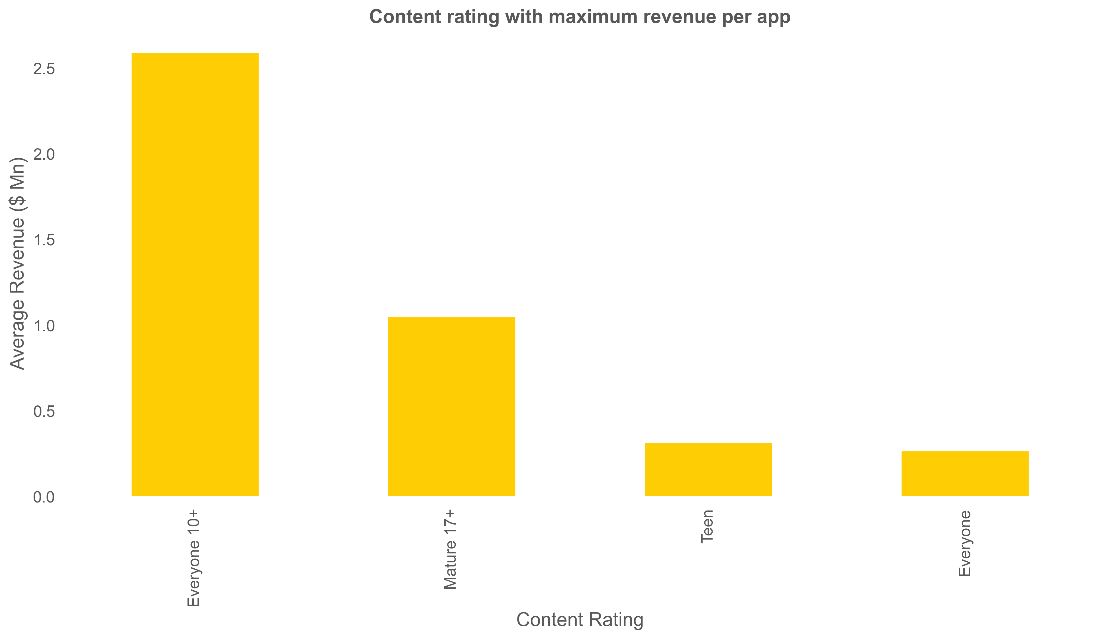
Content rating with maximum installations per app
Content rating with maximum revenue per app

Slide 44
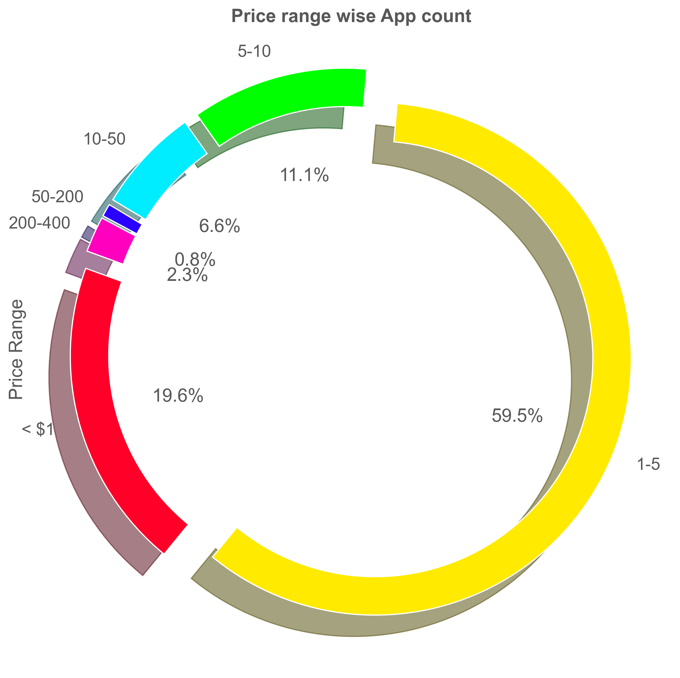
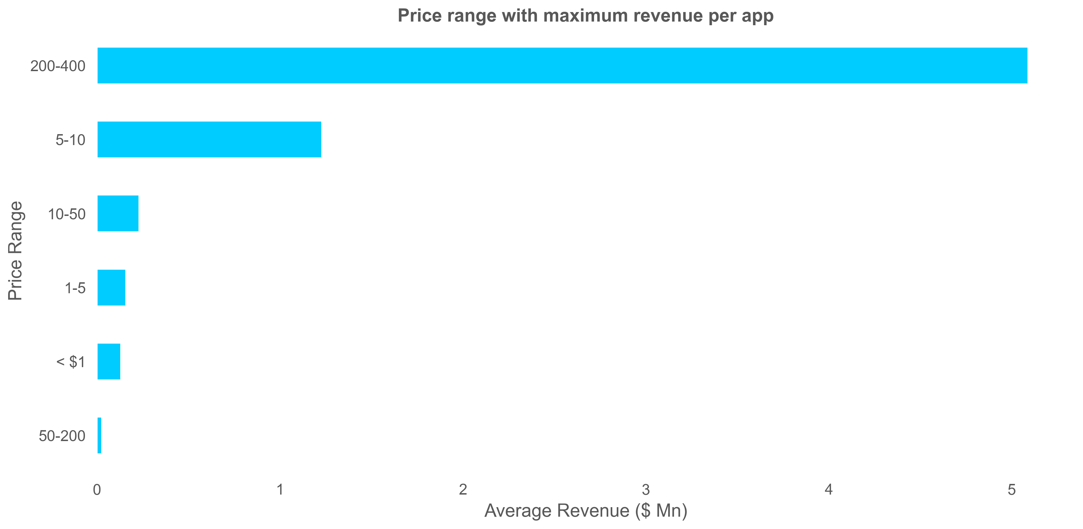
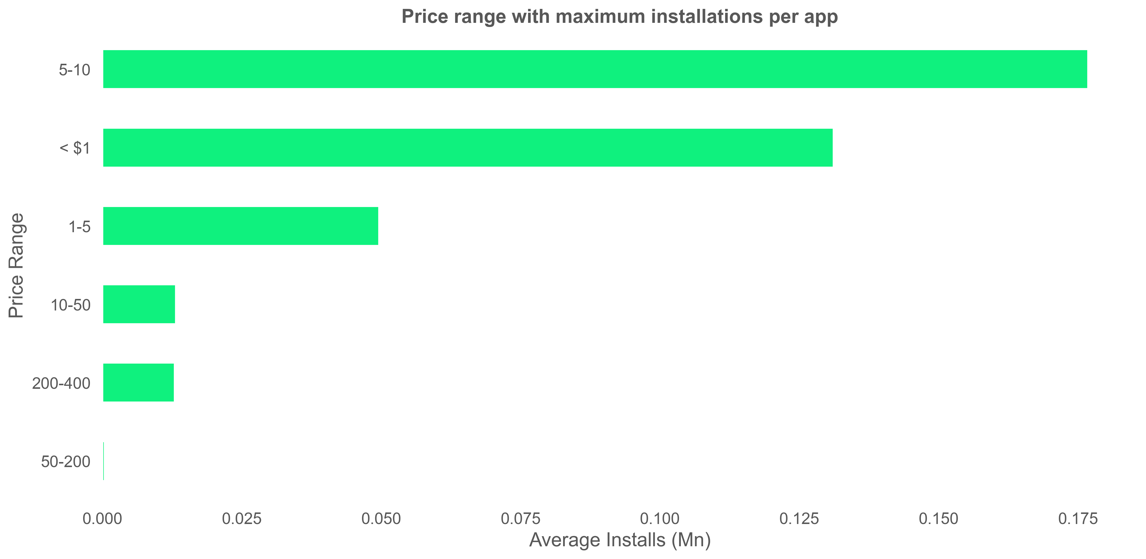
92% - Free
($)
($)
80%
($)

Slide 45
($)
($)

Slide 46
($)
($)
($)

Slide 47
($)
($)

Slide 48
($)
($)
($)

Slide 49
Conclusion
Category
Genre
Size
Content
Price
1
2
3
4
5
Communication, Game and Family
Action, Casual and Entertainment
Customary
< 20 MB
Everyone
Free
Unexplored
Video Players
Sports
50 - 80 MB
Teen
$ 5 - 10
Subscription
Lifestyle and Finance
Action
90 - 100 MB
Everyone
$ 200 - 400

Slide 50
Thank You!

